Slide 1
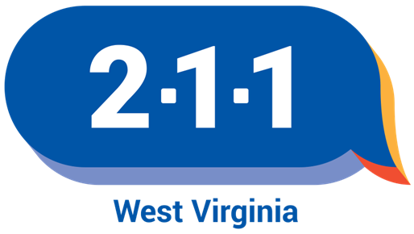
West Virginia 211
Making Connections During Disasters and Everyday
For WV VOAD Conference, September 24, 2024

Slide 2
West Virginia 211 Background
WV State Code 24-8-1: The Legislature further finds that implementing the "211" information and referral system will serve as a centralized resource for human and social service professionals, medical personnel, government agencies and charitable organizations by providing a full spectrum of service options to the citizens of West Virginia. The "211" system will also serve as a centralized point in times of natural disasters or national emergencies by providing access to information for the coordination of relief.
150-29-10: 10.1 As part of its duties, the 211 Provider shall be responsible for creating, maintaining and updating an electronic database of all community-based social and other services providers within the state…

Slide 3
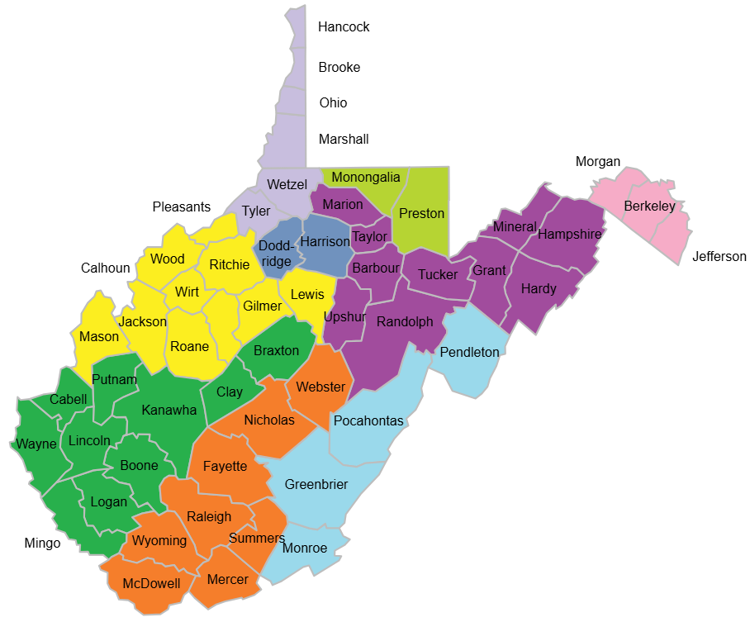
Who We Are
WV 211 consists of a team of caring and knowledgeable Community Resource Specialists at 9 United Way offices.
Living and working in different regions across West Virginia helps us maintain close ties with local resources.

Slide 4
How does 211 work?
Individual reaches out via call, text, or live chat.
We listen with empathy and without judgment to identify needs.
We collect demographic and eligibility information.
We search the database and provide referrals for appropriate resources.
The interaction is thoroughly documented to enable quality data reporting.

Slide 5
WV 211 Call Volume
Over 156,000 contacts and counting!

Slide 6
2023 Connections
Phone Calls
26,546
Live Chats
3,196
Texts
3,222
Emails
132
Walk-ins
331
Website Searches
80,035

Slide 7
Top Needs Categories – 2023
52,714 needs identified
116,917 referrals
made

Slide 8
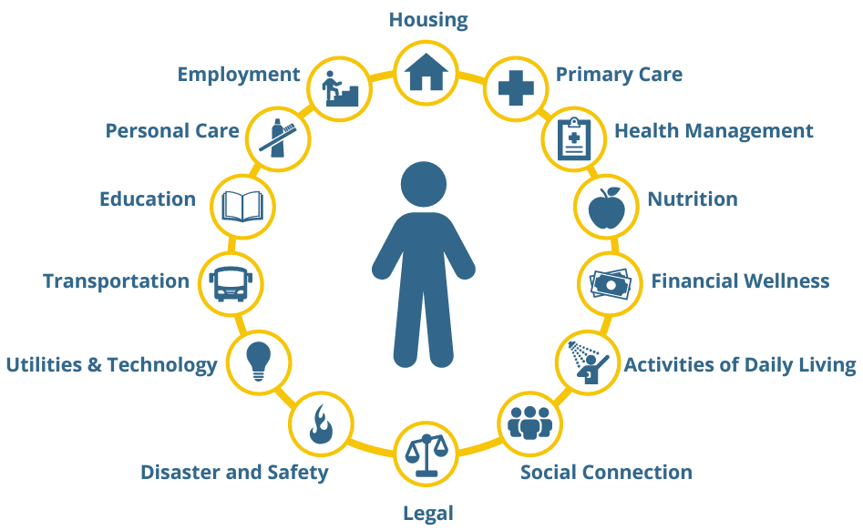
WV 211 Resource Database
WV 211 maintains a list of programs that provide a wide range of health, human, and social services.
The database also plays a vital role in helping communities respond to disasters and other emergencies.

Slide 9
WV 211 Resource Database
Resources are verified annually, using a variety of methods.
Resources are updated throughout the year on an as-needed basis.
New resources are added as requested by agencies or learned of through community outreach.
New resources are thoroughly researched and vetted prior to inclusion.
*Note: During disasters, we make every effort to verify information with individual resources as time allows; however, we may have to include resources that have not been thoroughly vetted through normal processes. This could include social media posts made directly by the resource (not a 3rd party). Sources of information are important to document on each new resource added for the event.

Slide 10
WV 211 Resource Database
19,236
Services
5,896 Programs
3,250 Locations
THANK YOU!
Last year, we added, updated, and/or verified nearly 10,000 records, with the help of resource representatives across the state and country.
We could not do this without you!
1,789 Agencies

Slide 11
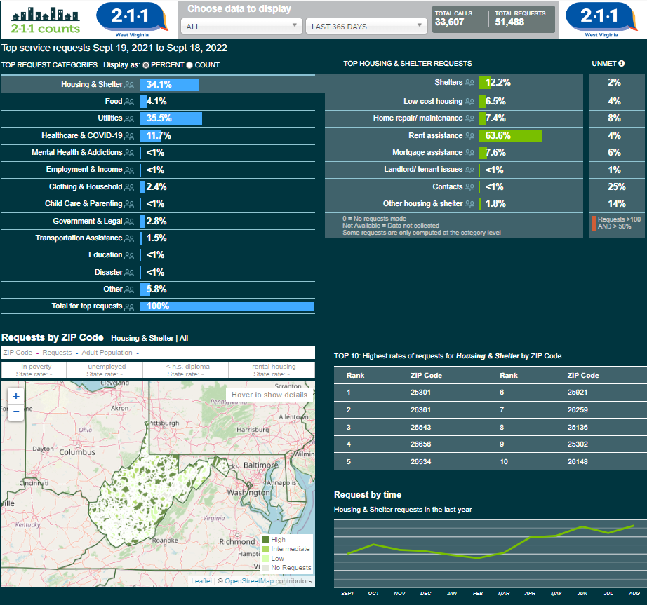
211Counts West Virginia
We are happy to publish our data freely online, which is updated daily.
Data can be filtered on many geographic levels—statewide, county, congressional district, and individual zip codes.
Date ranges can be customized.
Needs categories are broken down into more specific topics.

Slide 12
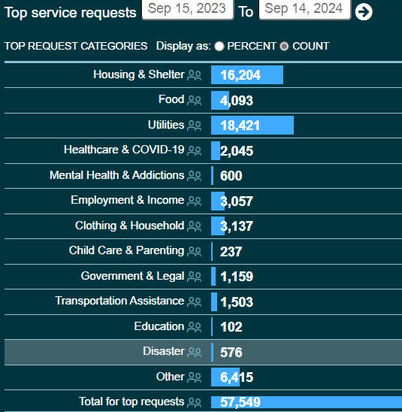
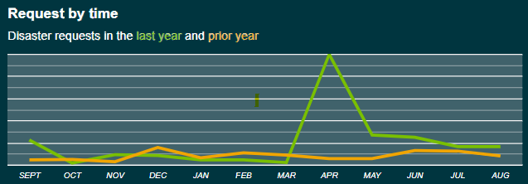
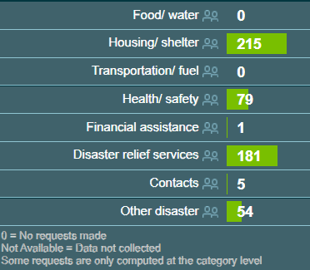
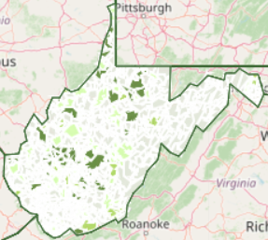
Data on 211Counts

Slide 13
211 During Disasters
Resource Database
Maintenance of resource database. Connection with resources within disaster area to discover new resources to meet community needs.
Information Monitoring
Social media and mass media is monitored for information about resources and changing situations.
Lend a Hand
Work cooperatively with other organizations. Share information about resources and caller needs.
Referral of callers to services and/or volunteer opportunities. Assistance completing Survey 123 for callers with no other access.
Reporting
Production of reports regarding disaster-related referrals, access to services, service availability, and unmet needs. Online publication of data daily.
Referrals
Data Collection
Documentation of caller demographics, location, and met/unmet needs.

Slide 14
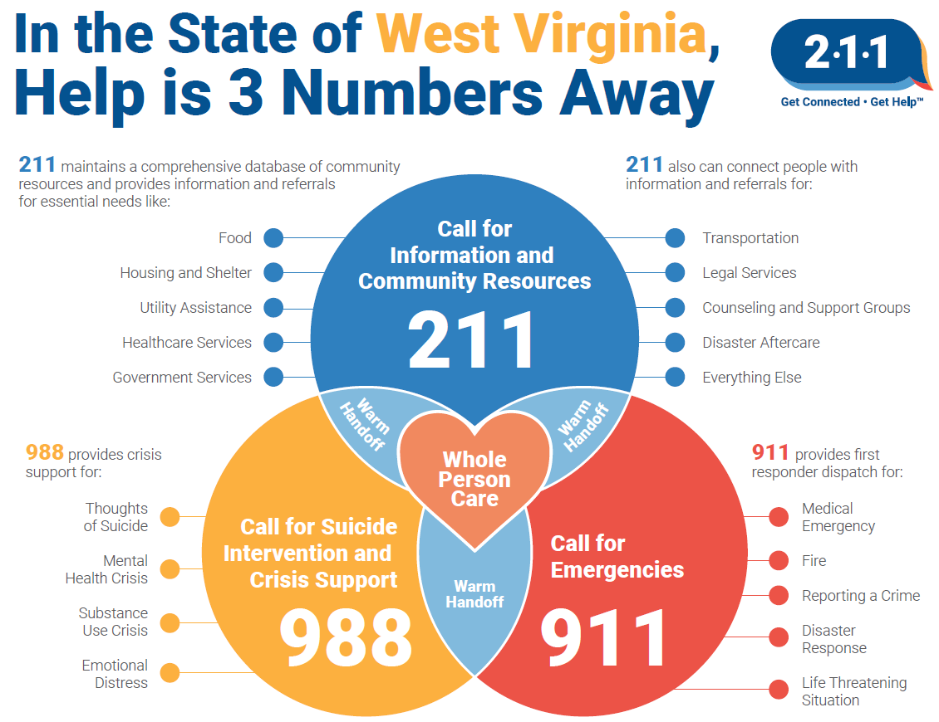

Slide 15
How Can We Help?
We can help manage non-emergency phone calls during disasters to lessen the burden on other organizations, freeing them up for true emergencies.
Data is published daily for calls for help. Resource information shared with WVEM & WVVOAD as requested.
Let’s get together and plan for how WV 211 can be more helpful during times of disaster.
We can provide print materials for distribution to the public.

Slide 16
Thank you!
Any questions?
WV 211
Call: 211
Call: 833-848-9905
Text: ZIP code to 898-211
Chat: wv211.org/contact
April Knight
State Director
681-710-1970
april@wv211.org

