Slide 1
FEMA Support to West Virginia in 2024
26, September 2024

Slide 3
WV Individual Assistance Disasters, 2014-present

Slide 4
WV Public Assistance Disasters, 2014-present
Notes:
West Virginia Public Assistance Declarations, 2014-present.

Slide 5
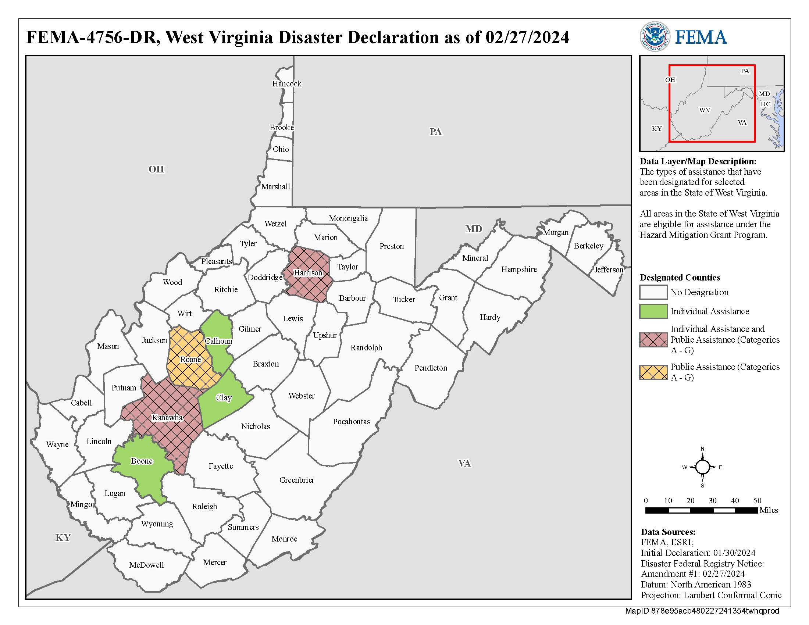
DR-4756
Incident Period: August 28-30, 2023
Declaration Date: January 30, 2024
IA Counties: Boone, Calhoun, Clay, Harrison, and
Kanawha
PA Counties: Harrison, Kanawha, and Roane

Slide 6
DR-4756 Assistance
IA Registrations: 640
IHP: $2,267,466
DRC Visits: 691
Group Flood Insurance: 32 households for $76,800
PA Obligations ( federal share to-date): $1,243,284

Slide 7
DR-4756
Challenges
Best Practices
5-month time difference between declaration request and approval
Implementation of new expectations for expedited FEMA Response & Recovery support
Operating DRCs in winter weather conditions
On site engineers to help promote Mitigation and Consensus Based Codes, Standards and Specifications
Early deployment of Disability Integration Advisor and engagement with disability partners

Slide 8
Notes:
At FEMA we are adapting to meet the needs of survivors. With the increased frequency of extreme weather events, improving the way FEMA operates is more important than ever. On January 19, the Individual Assistance team rolled out changes crucial to helping disaster survivors recover faster. These took effect on March 22, 2024. These changes were in effect for DR-4783 and DR-4787 and helped us help survivors more quickly and easily.
These changes address direct feedback from survivors and help us prepare for the challenges our nation faces due to the changing climate. They create more equitable outcomes for all communities by increasing accessibility and eligibility for post-disaster support. These changes:
Establish new benefits. This includes the implementation of Serious Needs Assistance, which provides immediate cash needs, The other new benefit, Displacement Assistance, is designed to more quickly assist survivors who cannot return home after a disaster.
Expand eligibilities. This includes removing loan application requirements, helping underinsured survivors, changing habitability criteria and making accessibility improvements.
Simplify the application process. This includes removing barriers for late applicants, streamlining temporary housing assistance applications and simplifying the appeals process.
Here are a few of the biggest changes we made:
Survivors no longer have to apply for a disaster loan from the U.S. Small Business Administration prior to accessing FEMA assistance. We streamlined the assistance process, so survivors could apply to both agencies simultaneously.
We replaced Critical Needs Assistance with Serious Needs Assistance – a one-time $750 payment for essential items. It is now be provided in all disasters receiving Individual Assistance rather than waiting for a separate request from the State.
People who are underinsured may also now receive assistance from FEMA to help cover aspects of home repair up to the full $42,500 to jumpstart their recovery.
We established Displacement Assistance, which is a new benefit that will provide survivors with up-front funds to assist with immediate housing options of their choice to keep survivors housed.
We reformed our DisasterAssistance.gov website to make it easier for survivors to navigate and apply.

Slide 9
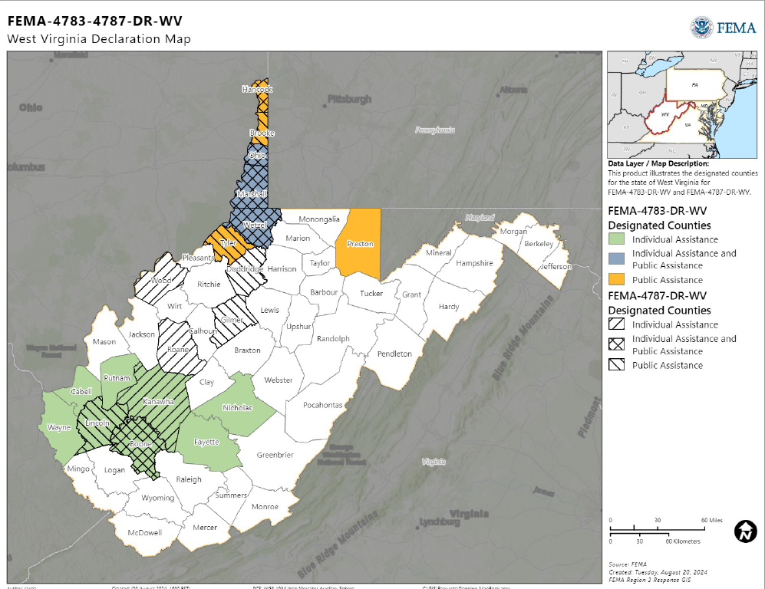
DR-4783-WV
Incident Period: April 2-6, 2024
Declaration Date: May 22, 2024
IA Counties: Boone, Cabell, Fayette, Kanawha,
Lincoln, Marshall, Nicholas, Ohio, Putnam,
Wayne, and Wetzel
PA Counties: Brooke, Hancock, Marshall, Ohio,
Preston, Tyler and Wetzel

Slide 10
DR-4783 Assistance (to-date)
IA Registrations: 2,301
IHP: $6,911,986
DRC Visits: 997
Serious Needs Assistance: 898 households for $673,000
Displacement Assistance: 706 households for $1,059,086
Group Flood Insurance: 125 households for $300,000
Projected PA Assistance (federal share): $28,510,382

Slide 11
DR-4783
Challenges
Best Practices
Pre and post IA reform messaging to survivors and the public
Overlapping counties and multiple events
First time implementing IA reform
Limited staffing availability
Utilizing WV FIT staff to pre-plan and staff events
Higher quality tents and equipment for mobile DRCs
Orientation for staff to better understand culture of WV

Slide 12
DR-4787-WV
Incident Period:
Declaration Date: May 24, 2024
IA Counties: Boone, Hancock, Kanawha, Marshall,
Ohio, Roane, Wetzel and Wood
PA Counties: Boone, Brooke, Doddridge, Gilmer,
Hancock, Lincoln, Marshall, Ohio, Tyler, and Wetzel

Slide 13
DR-4787 Assistance (to-date)
IA Registrations (to-date):590
IHP: $2,312,111
IHP from EAS: $583,606
DRC Visits: 568
Serious Needs Assistance: 239 households for $179,250
Displacement Assistance: 275 households for $411,950
Group Flood Insurance Program: 79
Projected PA Assistance (federal share): $16,578,640

Slide 14
DR-4787
Challenges
Best Practices
Pre and post IA reform messaging to survivors and the public
Overlapping counties and multiple events
Limited staffing availability
IA add-on for Boone County
Utilizing WV FIT staff to pre-plan and staff events
Higher quality tents and equipment for mobile DRCs
Orientation for staff to better understand culture of WV

Slide 15
Disaster Survivor Assistance
DR-4756
Homes Visited: 2,800
Survivor Interactions: 1,074
Registrations: 77
Community Contacts: 89
DR-4783
Homes Visited: 22,289
Survivor Interactions: 5,699
Registrations: 280
Community Contacts: 490
DR-4787
Homes Visited: 4,107
Survivor Interactions: 1,347
Registrations: 73
Community Contacts: 374

Slide 16
Enhanced Applicant Services
FEMA’s Enhanced Applicant Services (EAS) is tasked with locating applicants challenged by navigating the application and appeals process.
IA Specialists reached out to survivors whose applications lacked documentation, such as proof of ownership and occupancy, or populations who required additional support, including people with access or functional needs, people 65 years of age or older, with zero or low income, or those who may have difficulty understanding and advancing through the recovery process.
EAS Funding Summary
DR-4756 | DR-4783 | DR-4787
$772,512 | $1,483,147 | $583,606

Slide 17
Disability Integration
Provided disability subject matter expertise to disaster leadership and FEMA program areas
Provided data analysis to enable FEMA Programs to meet the needs of people with disabilities impacted by the disaster
Assisted with navigating the FEMA sequence of delivery and shortening the recovery of survivors with disabilities and their families.
Assisted IA operations to identify unmet needs of people with disabilities impacted by the disaster through:
Communications with local disability organizations and service providers
Communicating situational awareness to IA staff
Provided training and programmatic recommendations to relevant FEMA Program areas

Slide 18
Small Business Administration Funding
DR-4756
Full Application Count: 77
Disbursed Amount: $154,200
DR-4783
Full Application Count: 142
Disbursed Amount: $737,132
DR-4787
Full Application Count: 33
Disbursed Amount: $135,500

Slide 19
WV FIT Updates
Continue to expand staffing and capabilities
Moved into new office with enough space for steady-state and disaster staff
Held annual meeting with WVEMD to set annual priorities for FIT support
Several staff members were deployed in primary and collateral duties for all three events in 2024
Continue to pre-identify potential DRC locations and group housing sites across the state

Slide 20
Questions?
James Young
Disaster Field Coordinator
james.young@fema.dhs.gov
202-394-0229

