Slide 1
Climate Change in West Virginia
A Hot Topic!

Slide 2
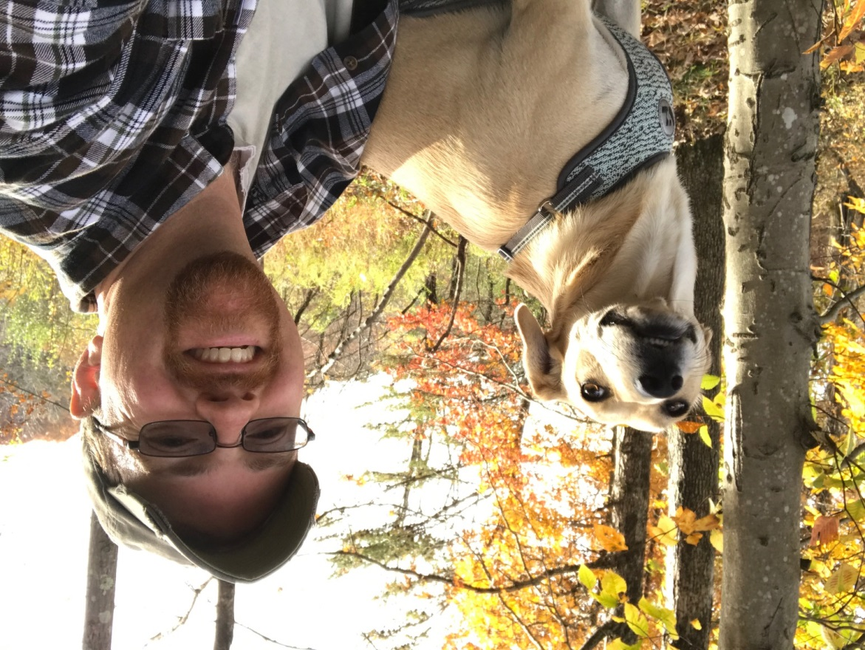
Tony Edwards
Warning Coordination Meteorologist
NOAA/National Weather Service
Charleston, WV
304-356-3390
Tony.Edwards@noaa.gov
Warning Coordination Meteorologist serves as the principle interface between the Weather Forecast Office and the users of its products and services and leads the effort to insure their evaluation, adjustment and improvement.

Slide 3
Disclaimer
I am a Meteorologist, not a Climatologist.
No politics!
I am not on social media nor do I get my climate science information from social media! It’s a great way to live life! I encourage others to try it.
I will try my best to suppress my own opinions, but if one slips out, they are mine only and do not represent DOC/NOAA/NWS etc.

Slide 4
Agenda
Yes, climate change is real. I can prove it!
A little about my travels and how climate change became real to me
The Data
Worldwide
West Virginia
Is climate change human caused?
Potential impacts to WV in the future
Citizen scientists - help us monitor the weather and climate!

Slide 5
Climate Change is Real, I Can Prove It!
There was a flood:
Genesis 6-9
There was drought:
Haggai 1:11 - And I have called for a drought on the land and the hills, on the grain, the new wine, the oil, on what the ground brings forth, on man and beast, and on all their labors.

Slide 6
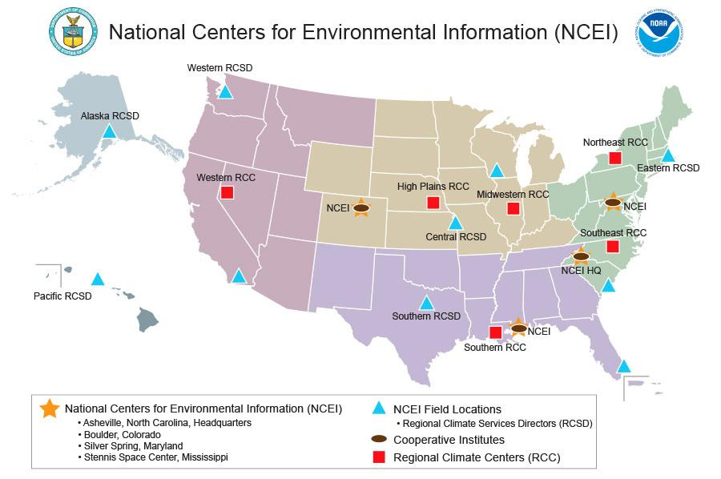
How Climate Change Became Real to Me

Slide 7
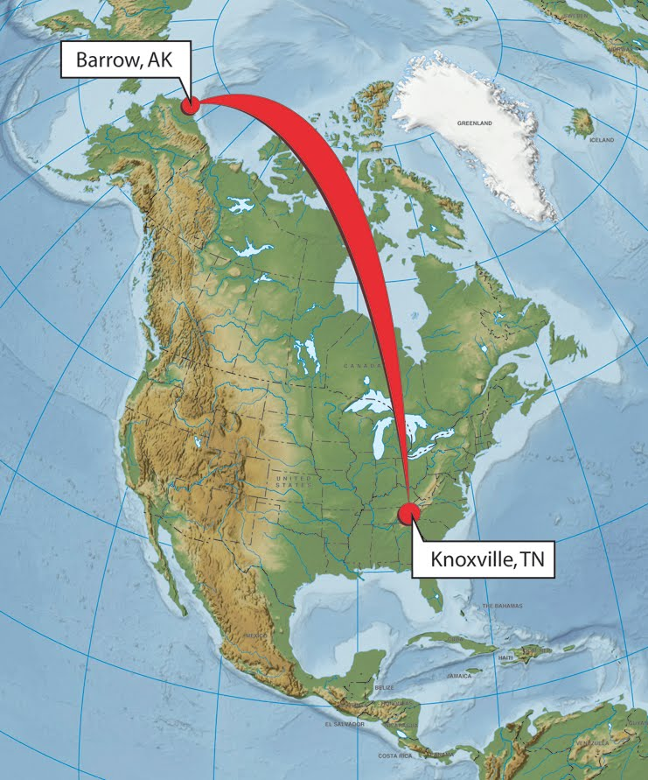
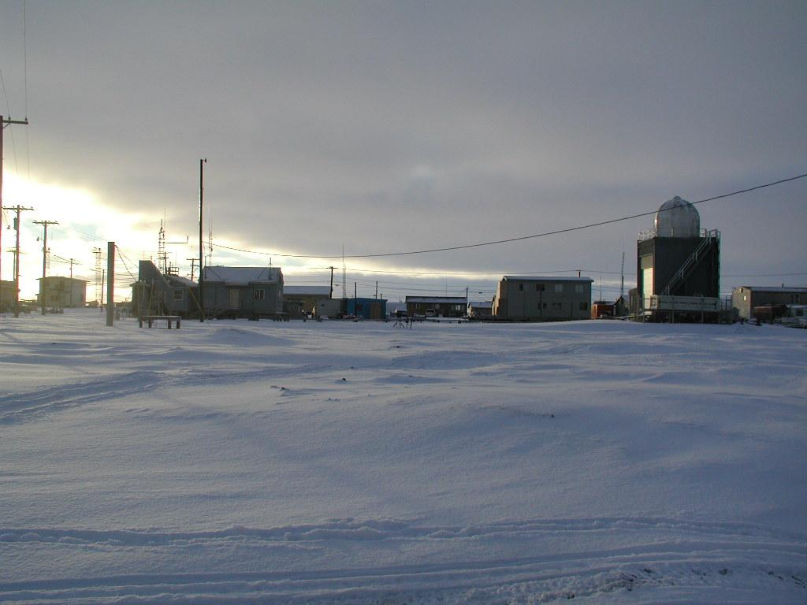
National Weather Service - Barrow, Alaska

Slide 8
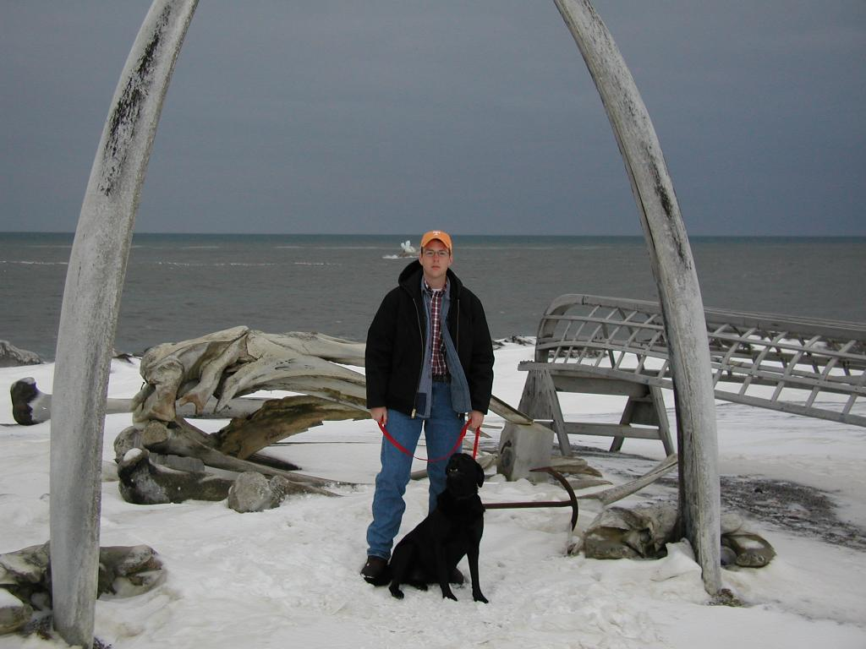
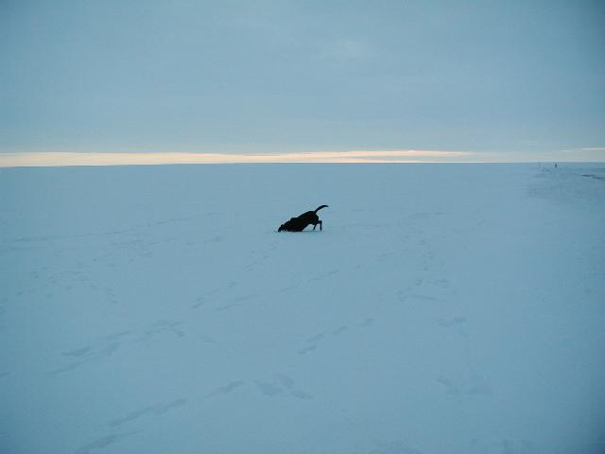
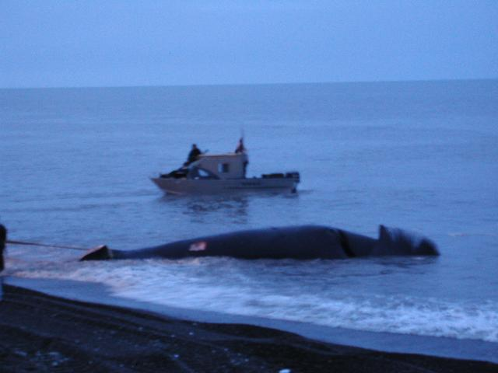
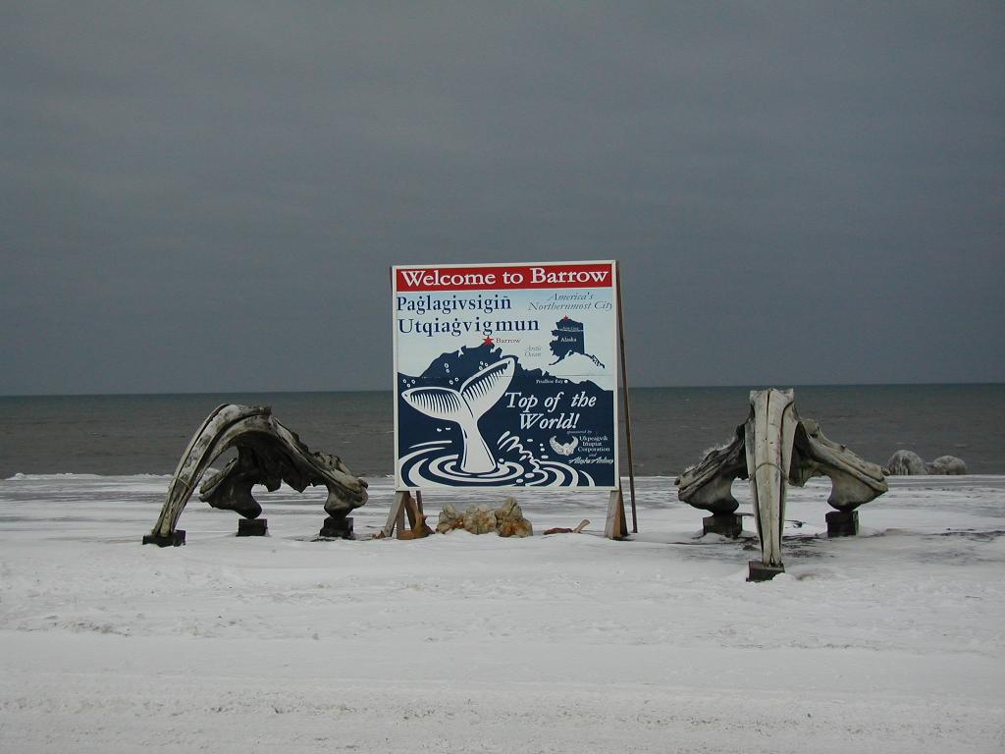

Slide 9
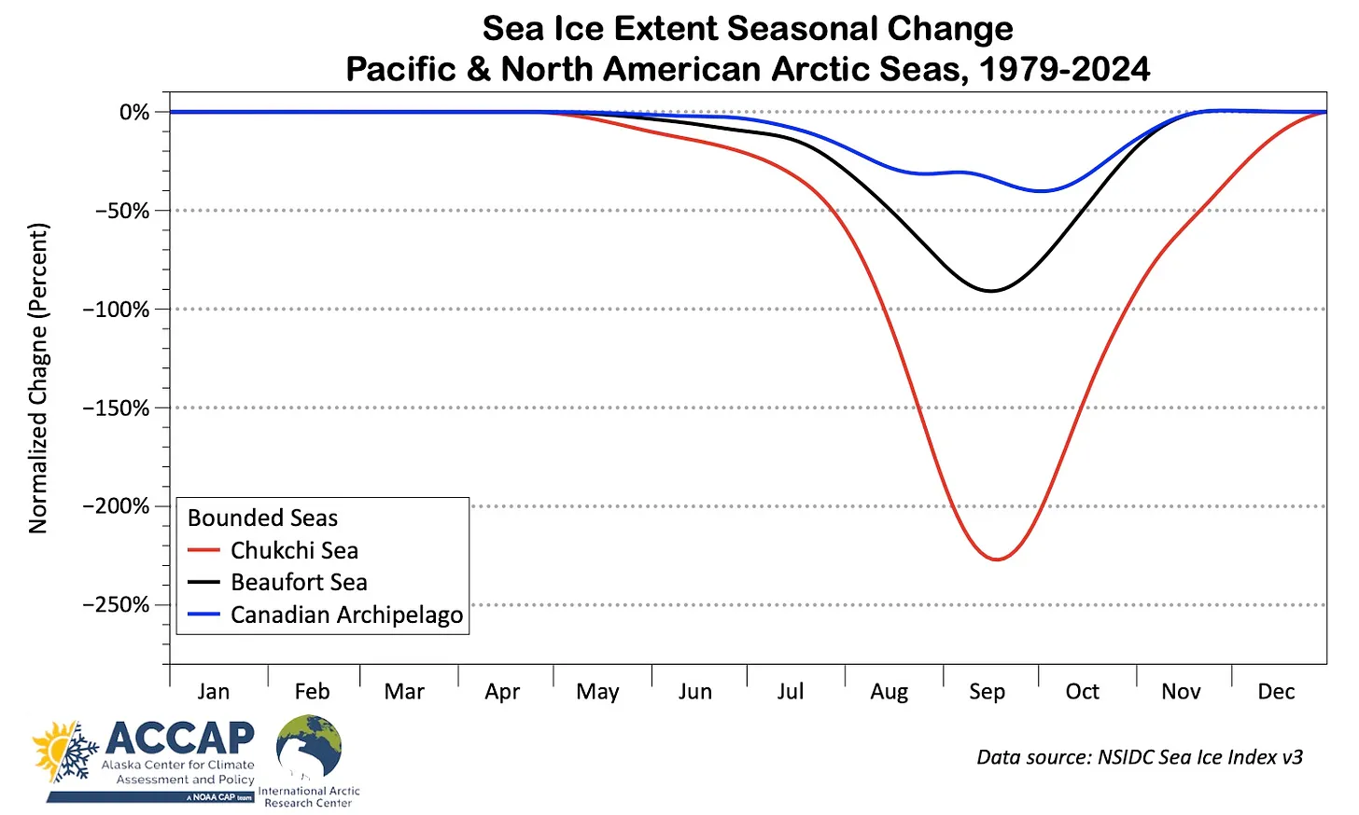
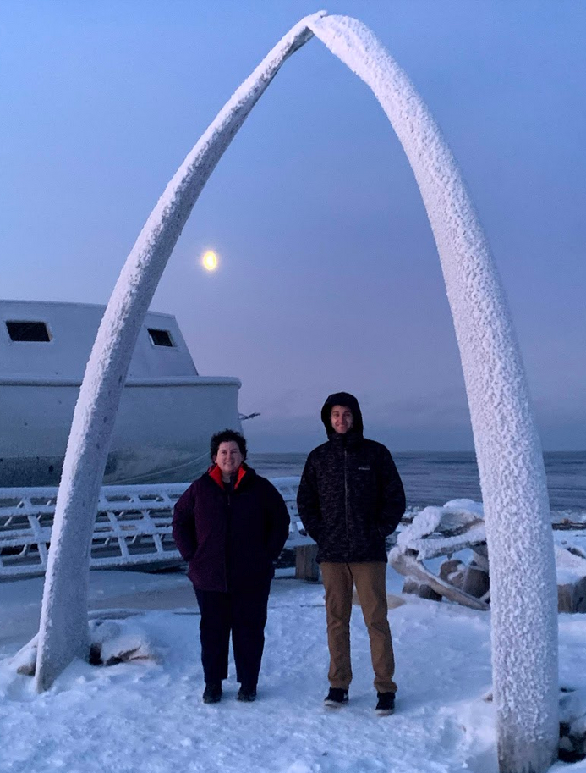
Real Climate Change
October 11, 2003
December 17, 2019

Slide 10
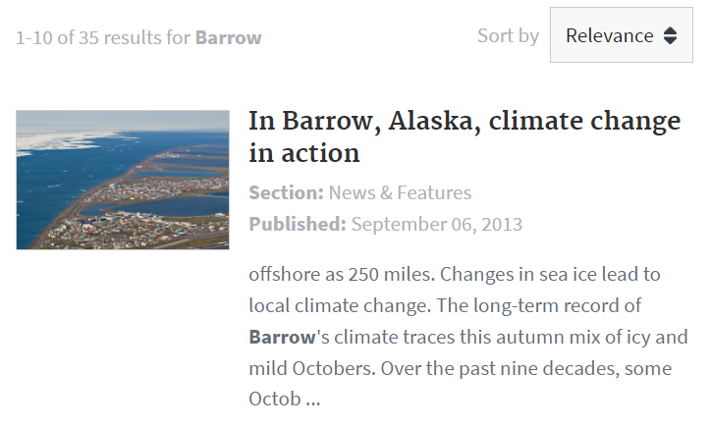
Real Climate Change

Slide 11
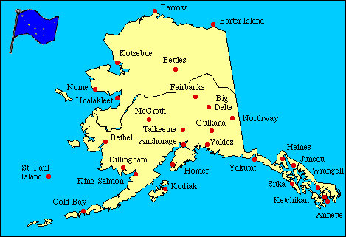
National Weather Service - Fairbanks, Alaska

Slide 12
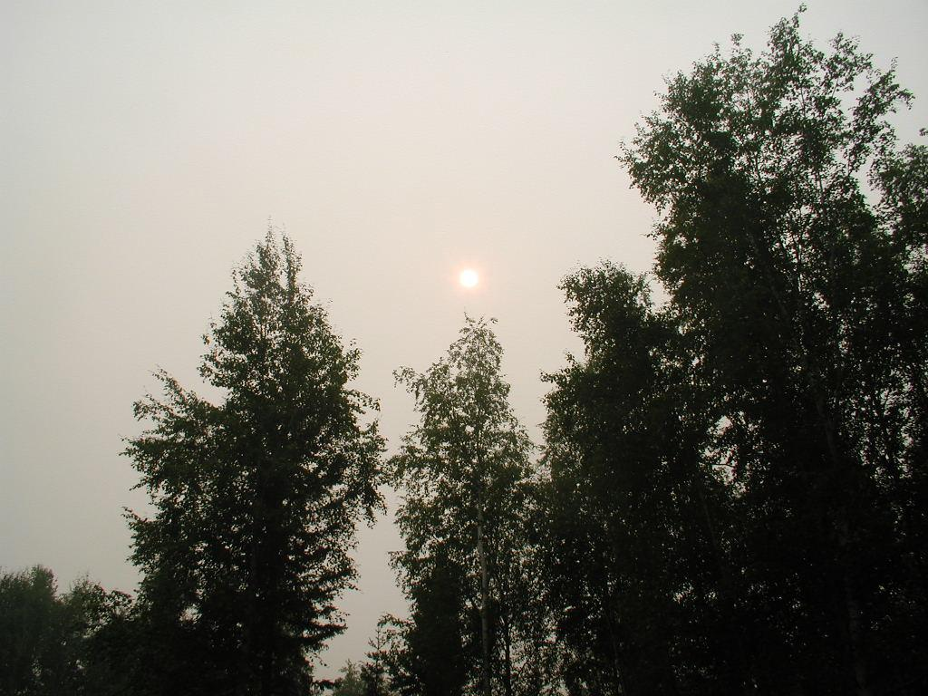
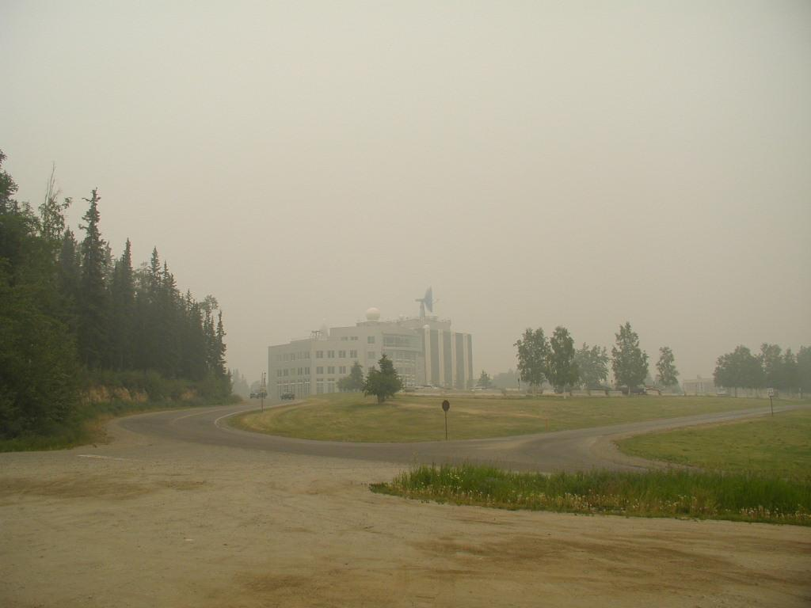
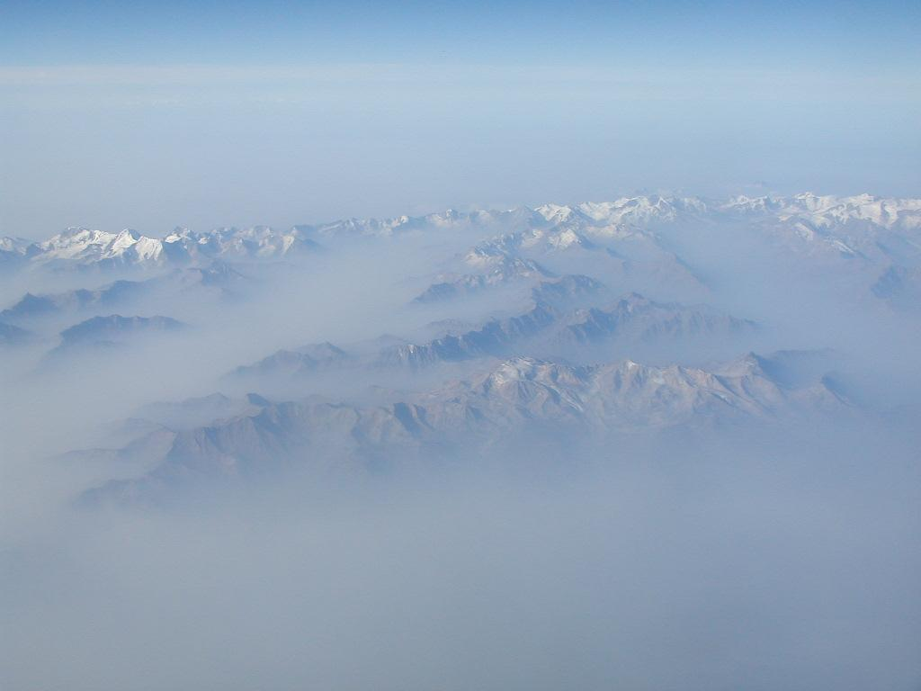
Real Climate Change

Slide 13
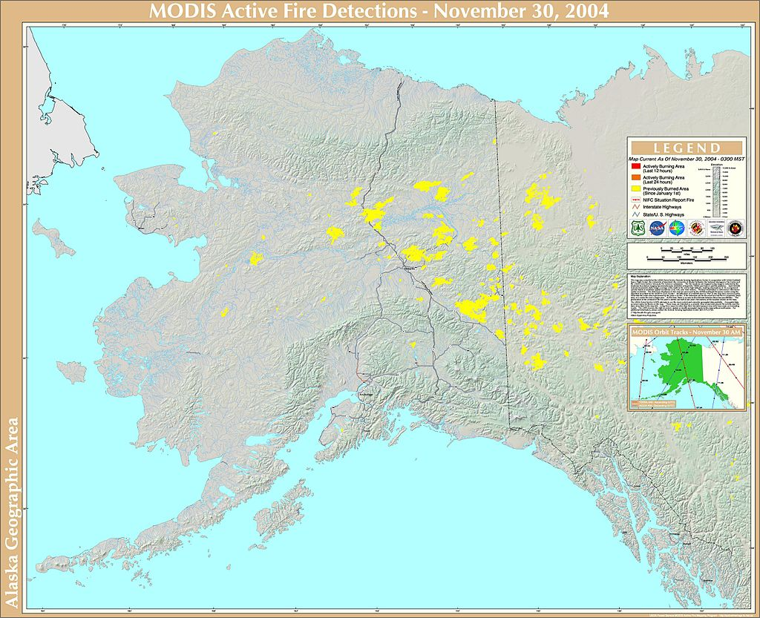
Real Climate Change
2004 Alaska Wildfires
Worst Wildfire Season on Record
701 fires burned 6,600,000 acres, or 10,300 square miles of land.
Maryland – 9,775 sq mi
The Taylor Complex consumed over 1,700,000 acres, or 2,700 square miles.
Delaware – 1,955 sq mi

Slide 14
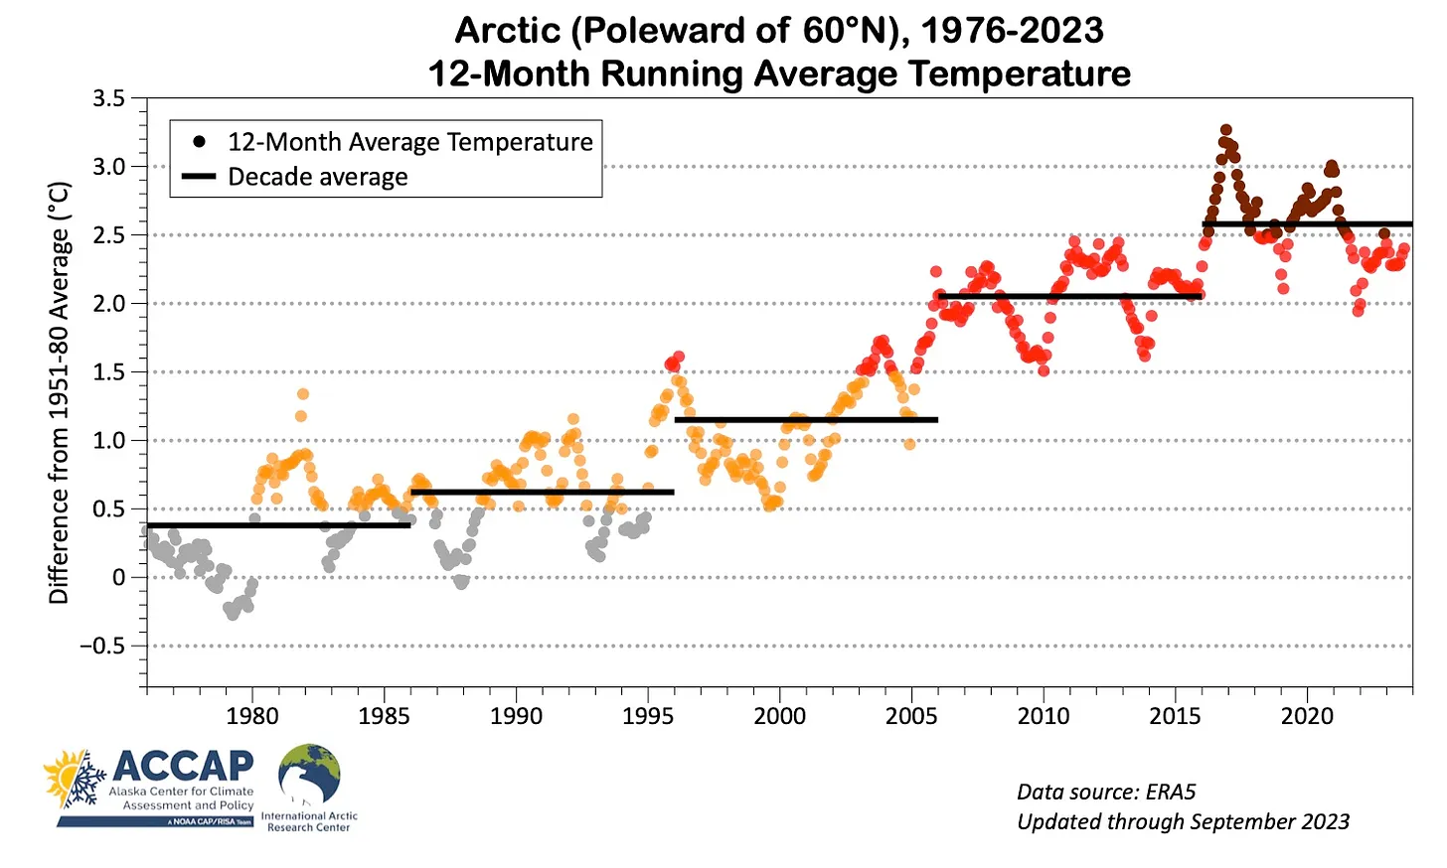
Real Climate Change

Slide 15
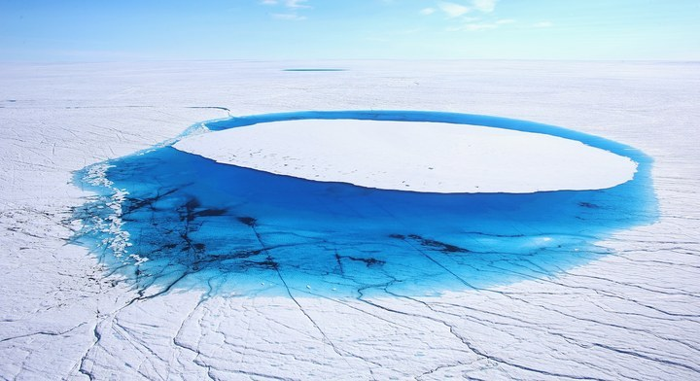
The Data

Slide 16
Scientific Consensus
97% of climate scientists agree that the earth is warming due to human activity
We have increased the amount of greenhouse gases over the last century-plus
The warming is not globally uniform
A few areas have actually cooled over time (SE US, North Atlantic)
wunderground.com

Slide 17
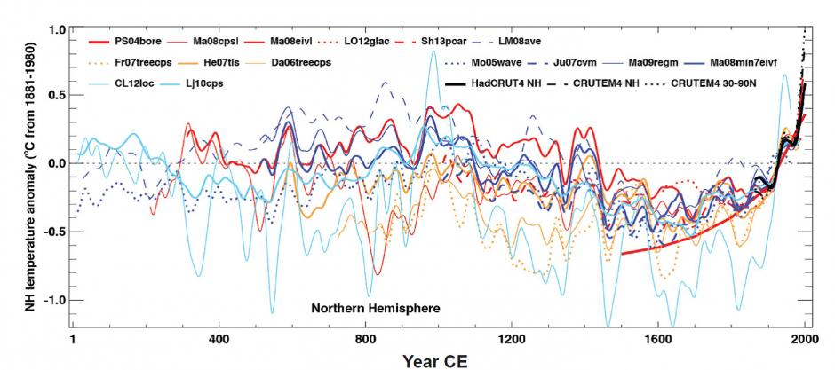
Global Land and Ocean Temperature Anomalies
-Proxy data sources, ice cores, tree rings, ocean sediments, can give us glimpse of past climate variability.
-Dramatic warming has occurred since the 19th century.
-For NH, the past 30 years is likely the warmest 30 year period in at least 1400 years.
Medieval Warm Period
Little Ice Age
https://www.ncei.noaa.gov/products/paleoclimatology/paleo-perspectives/global-warming

Slide 18
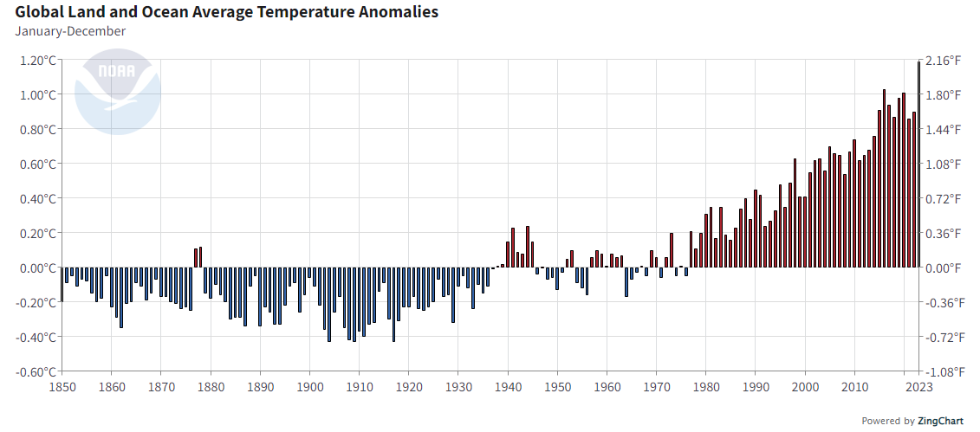
Global Land and Ocean Temperature Anomalies
-2023 was the warmest year in NOAAs global temperature record, which dates back to 1850.
-So far in 2024, the January-June global surface temperature ranked warmest in the 175-year record and July was the warmest July on record.
-There is 59% chance that 2024 will be the warmest year on record.
Anomalies are with respect to 20th century average
https://www.ncdc.noaa.gov/cag/

Slide 19
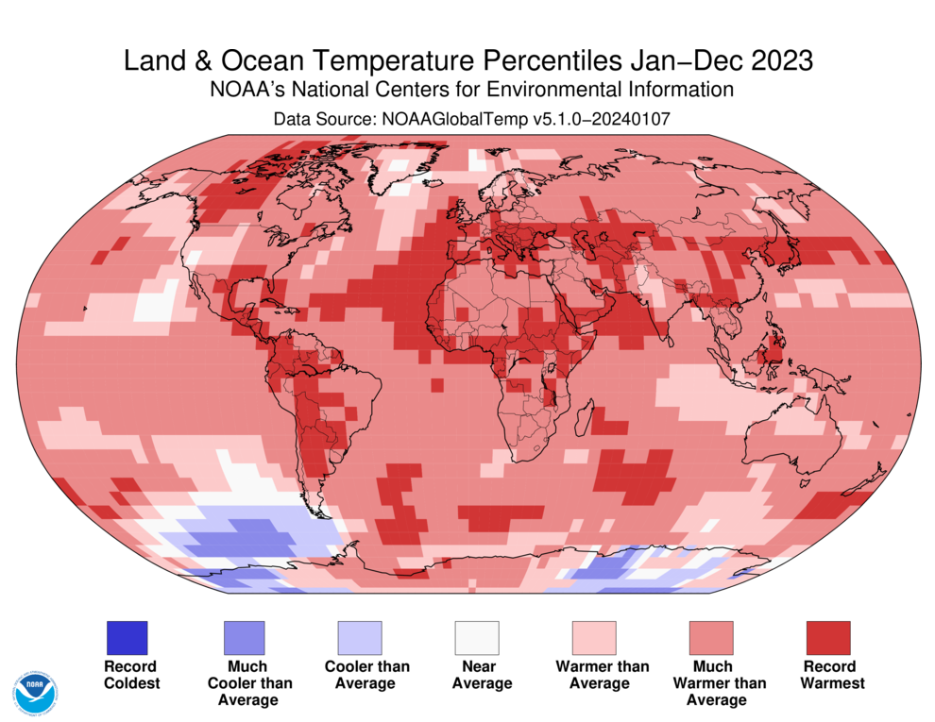
https://www.ncei.noaa.gov/news/global-climate-202112

Slide 20
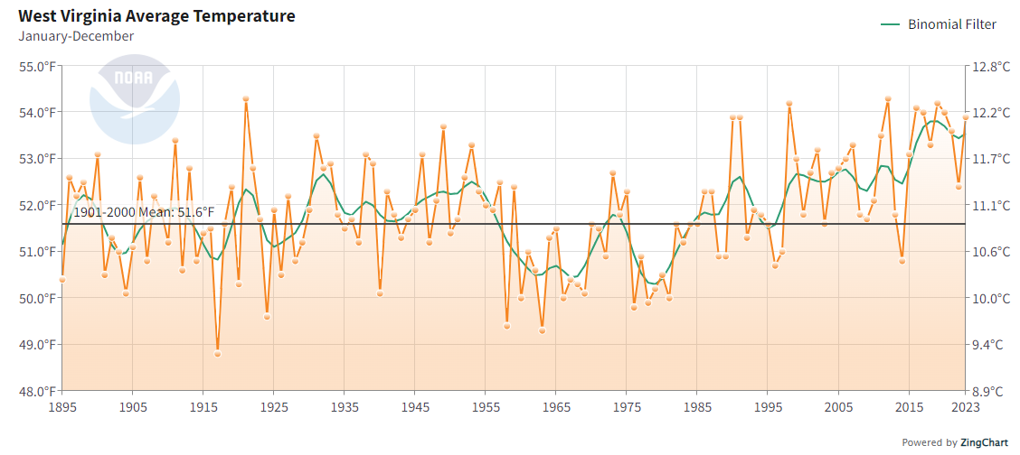
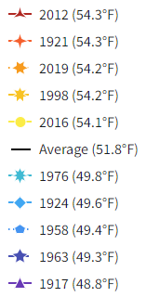
What about West Virginia’s Climate?
-4 of the 5 warmest years have occurred after 1997.
-The coldest years were 1976 or prior.
-Warmer air holds more water. For every 1.8 degrees of warming, the atmosphere can hold about 7% more moisture.
https://www.ncdc.noaa.gov/cag/

Slide 21
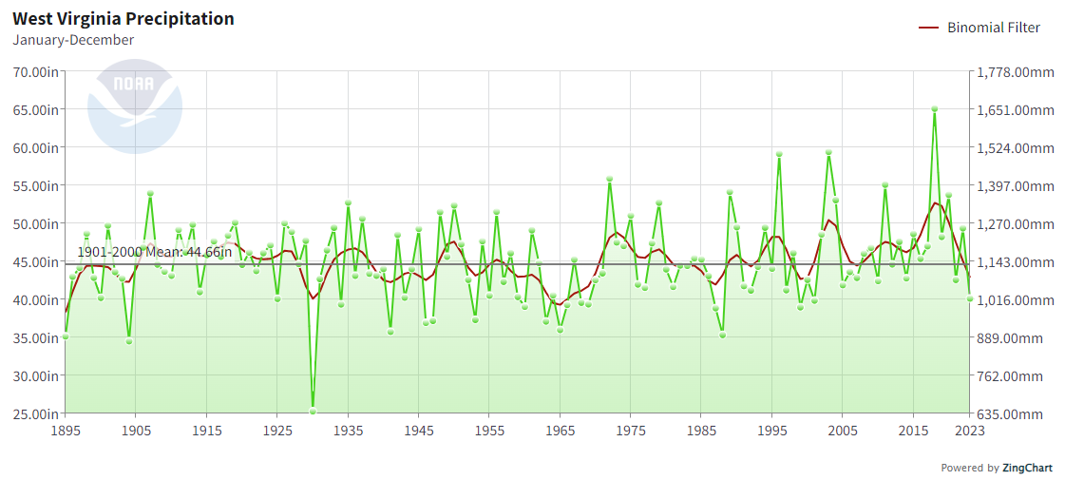
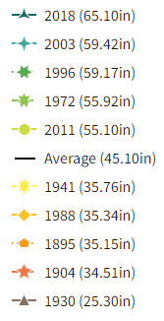
What about West Virginia’s Climate?
-4 of the 5 wettest years have occurred since 1996.
-The driest years were 1988 or prior.
https://www.ncdc.noaa.gov/cag/

Slide 22
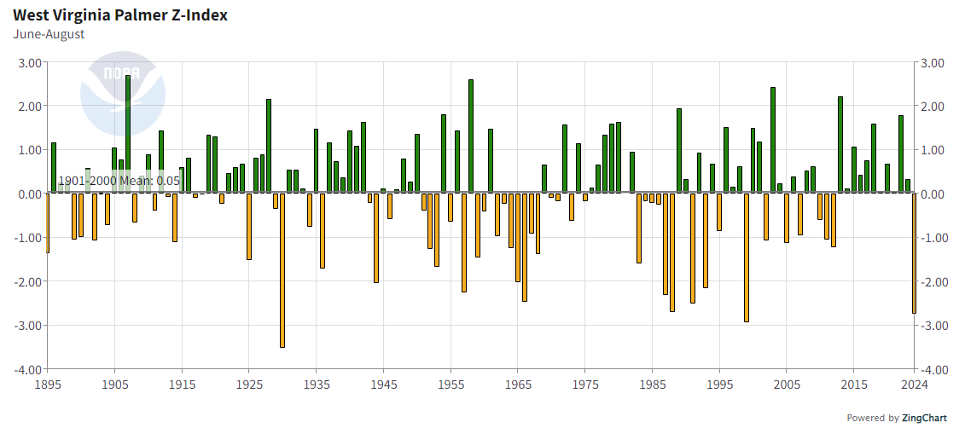
What about West Virginia’s Climate?
-Palmer-Z Index is a short term drought indicator.
-June-July-August 2024 was 3rd worst such period on record since 1895.
-Only 1930 and 1999 were worse.

Slide 23
Data Manipulation?

Slide 24
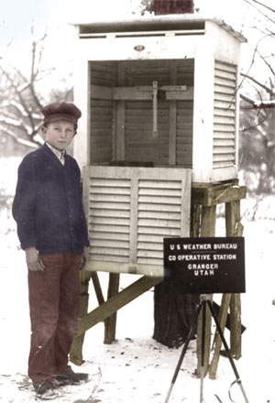
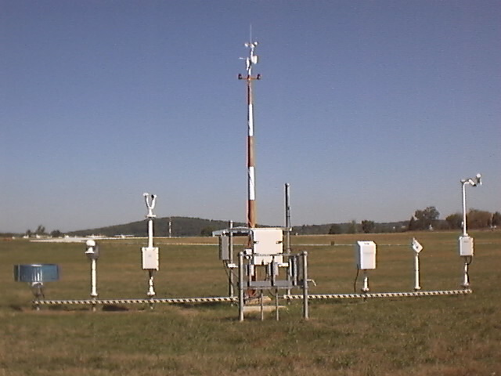
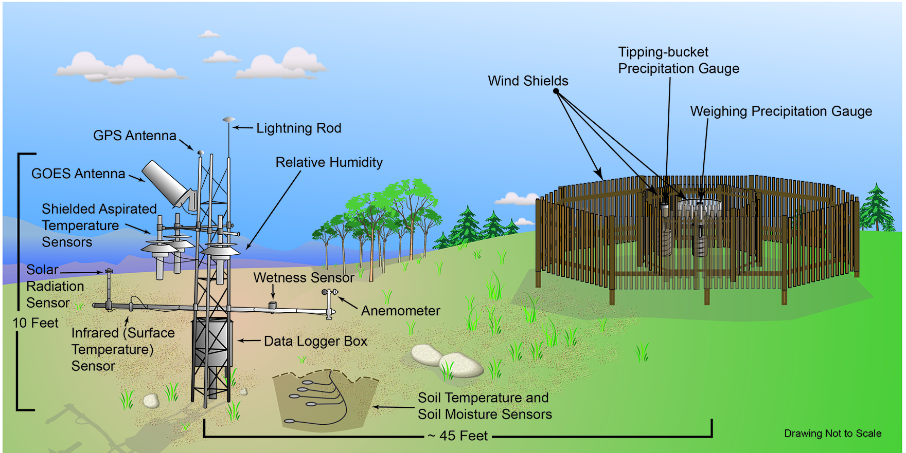
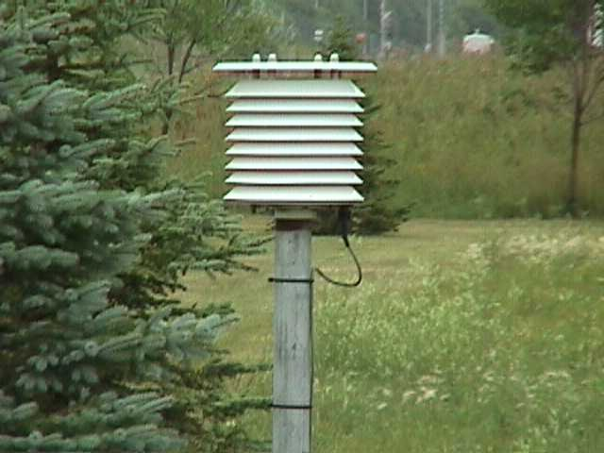
The Way We Measure Climate Has Changed Over the Years

Slide 25
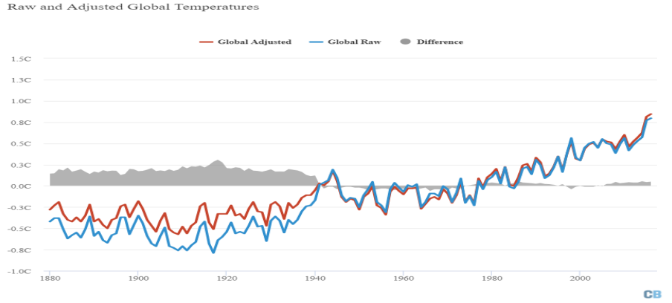
Data Manipulation?
The biggest adjustment to global temperatures occurred prior to the 1940s. This was needed to correct well understood biases in sea-surface temperature measurements, which were taken by sailors throwing buckets over the side of the boat to collect water samples. This practice changed in the 1940s to water temperature measurements being taken from engine intakes.
www.carbonbrief.org/explainer-how-data-adjustments-affect-global-temperature-records

Slide 26
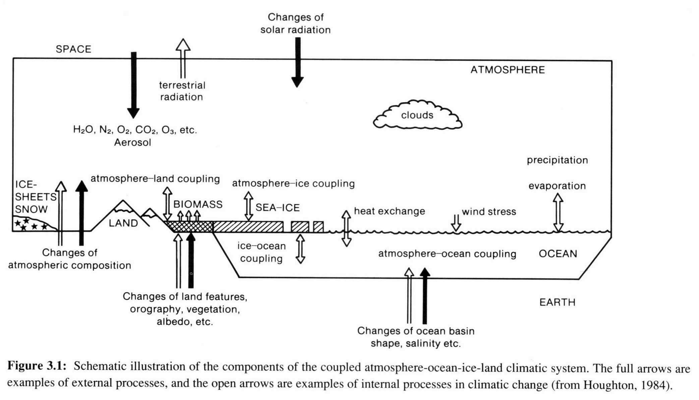
Is Climate Change Human Caused?
It’s COMPLICATED!

Slide 27
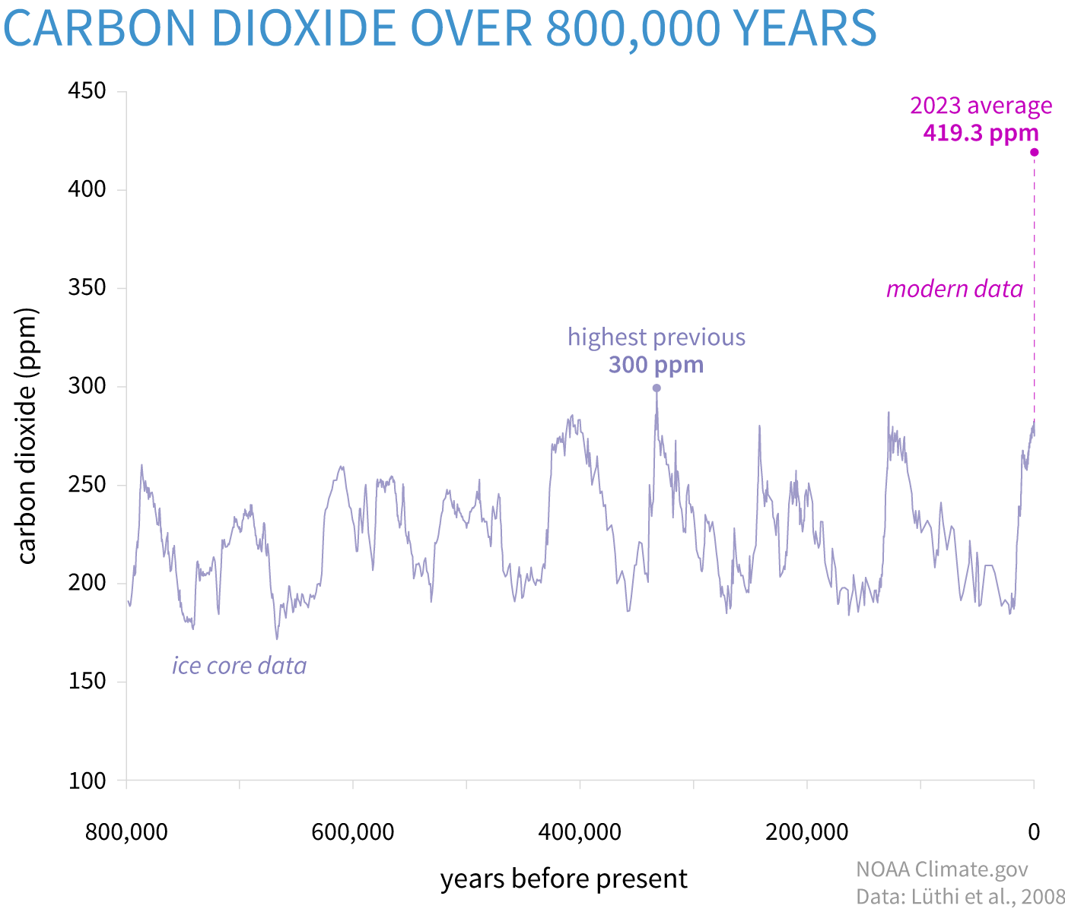
Is Climate Change Human Caused?
-Typical CO2 concentration over the past 800,000 years has been in the 170 to 300 ppm range.
-The last time CO2 concentration was this high was 3 million years ago during the Mid-Pliocene Warm Period
Temperature was 2.5-4C higher than during pre-industrial era
Sea Level was at least 16 feet higher than today.
Based on Ice Core Data
https://www.climate.gov/news-features/understanding-climate/climate-change-atmospheric-carbon-dioxide

Slide 28
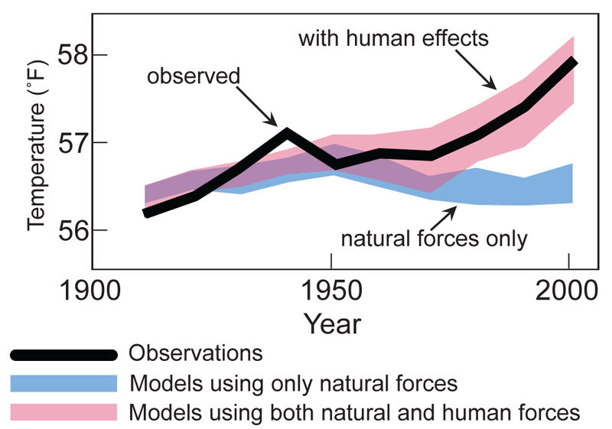
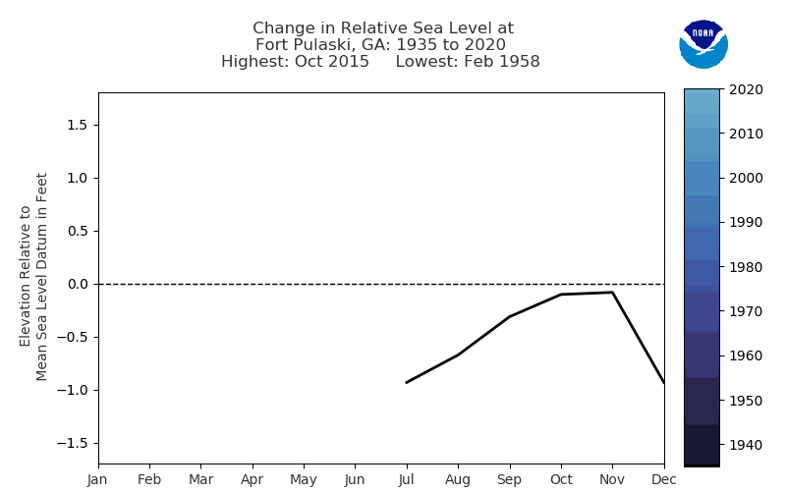
Is Climate Change Human Caused?
We try to simulate the chaotic relationships using General Circulation Models. These models when run with historical increases in greenhouse gases show:
Gradual warming of the Earth and ocean surface
Increases in ocean heat content
Rise in global sea level
General retreat of sea ice and snow cover

Slide 29
Future Impacts to West Virginia

Slide 30
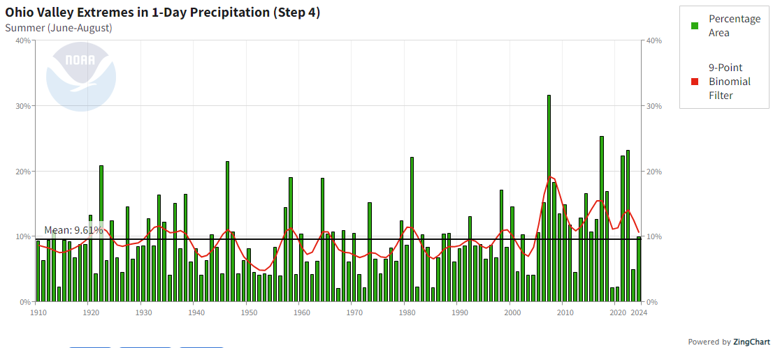
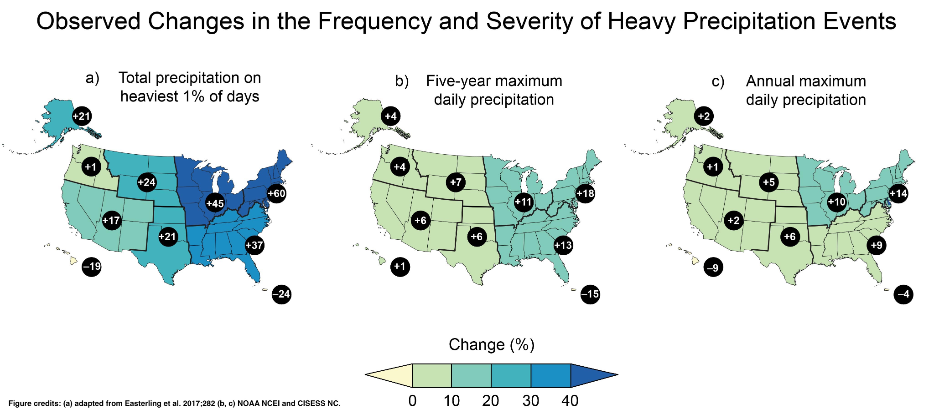
Future Impacts to West Virginia
-Recent trends of increasing extreme rainfall events should continue into the future.
-Flooding is already WV’s greatest weather hazard killing 99 people and causing billions of dollars in damages since 1990.
-Rural communities are especially vulnerable with little redundancy in their infrastructure.
https://www.ncdc.noaa.gov/extremes/cei/

Slide 31
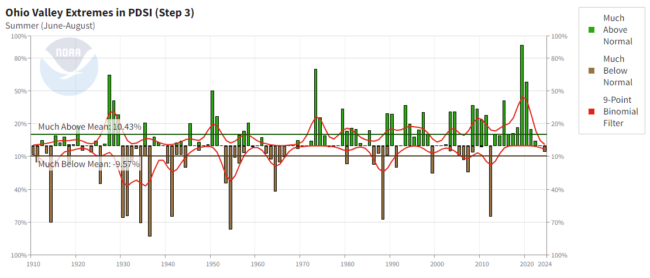
Future Impacts to West Virginia
-The PDSI helps us classify drought but can also show when we are abnormally wet.
-The overall trend in PDSI also indicates a wetter climate in recent decades punctuated by some intense periods of drought.
https://www.ncdc.noaa.gov/extremes/cei/

Slide 32
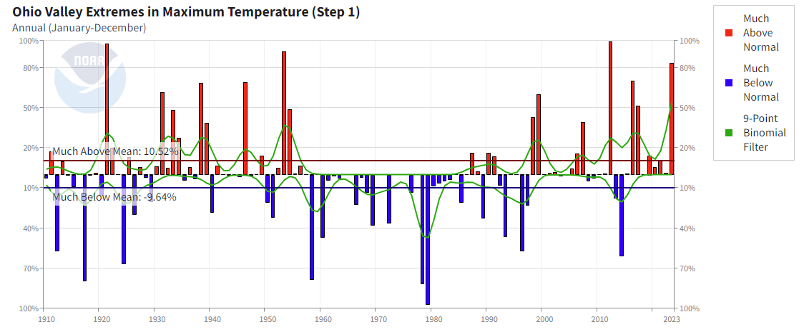
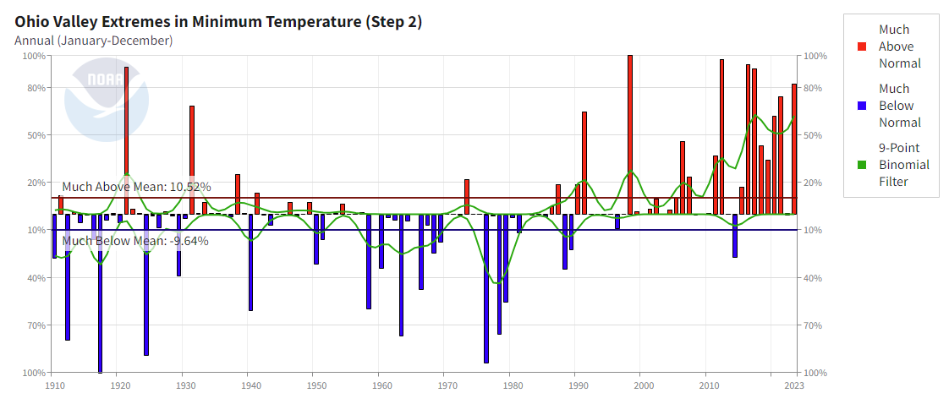
Future Impacts to West Virginia
-Extremes in maximum temperatures show quite a bit of variability over recent decades.
-Overnight temperatures have shown a tendency to be more extreme on the warm side (a wetter air mass is not as easy to cool at night).
-Future heat waves could be worsened by less cooling during the night time hours which seriously affects those without air conditioning.

Slide 33
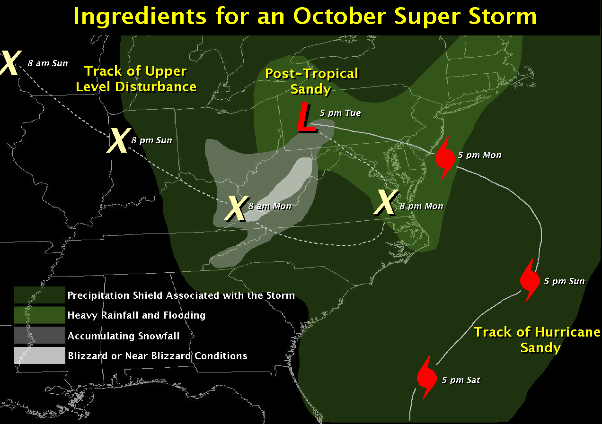
Future Impacts to West Virginia
-Future increases in precipitation are projected, especially in the winter and spring months over the Ohio Valley and central Appalachians.
-More of this precipitation is expected to fall as rain rather than snow.
-While this may result in declining winter snowfall amounts, it is unclear how climate change will affect the frequency or amplitude of significant winter storms.

Slide 34
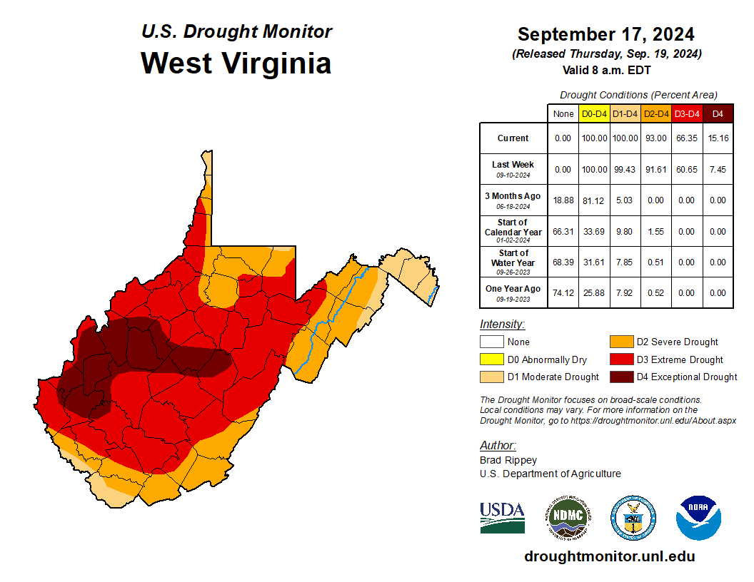
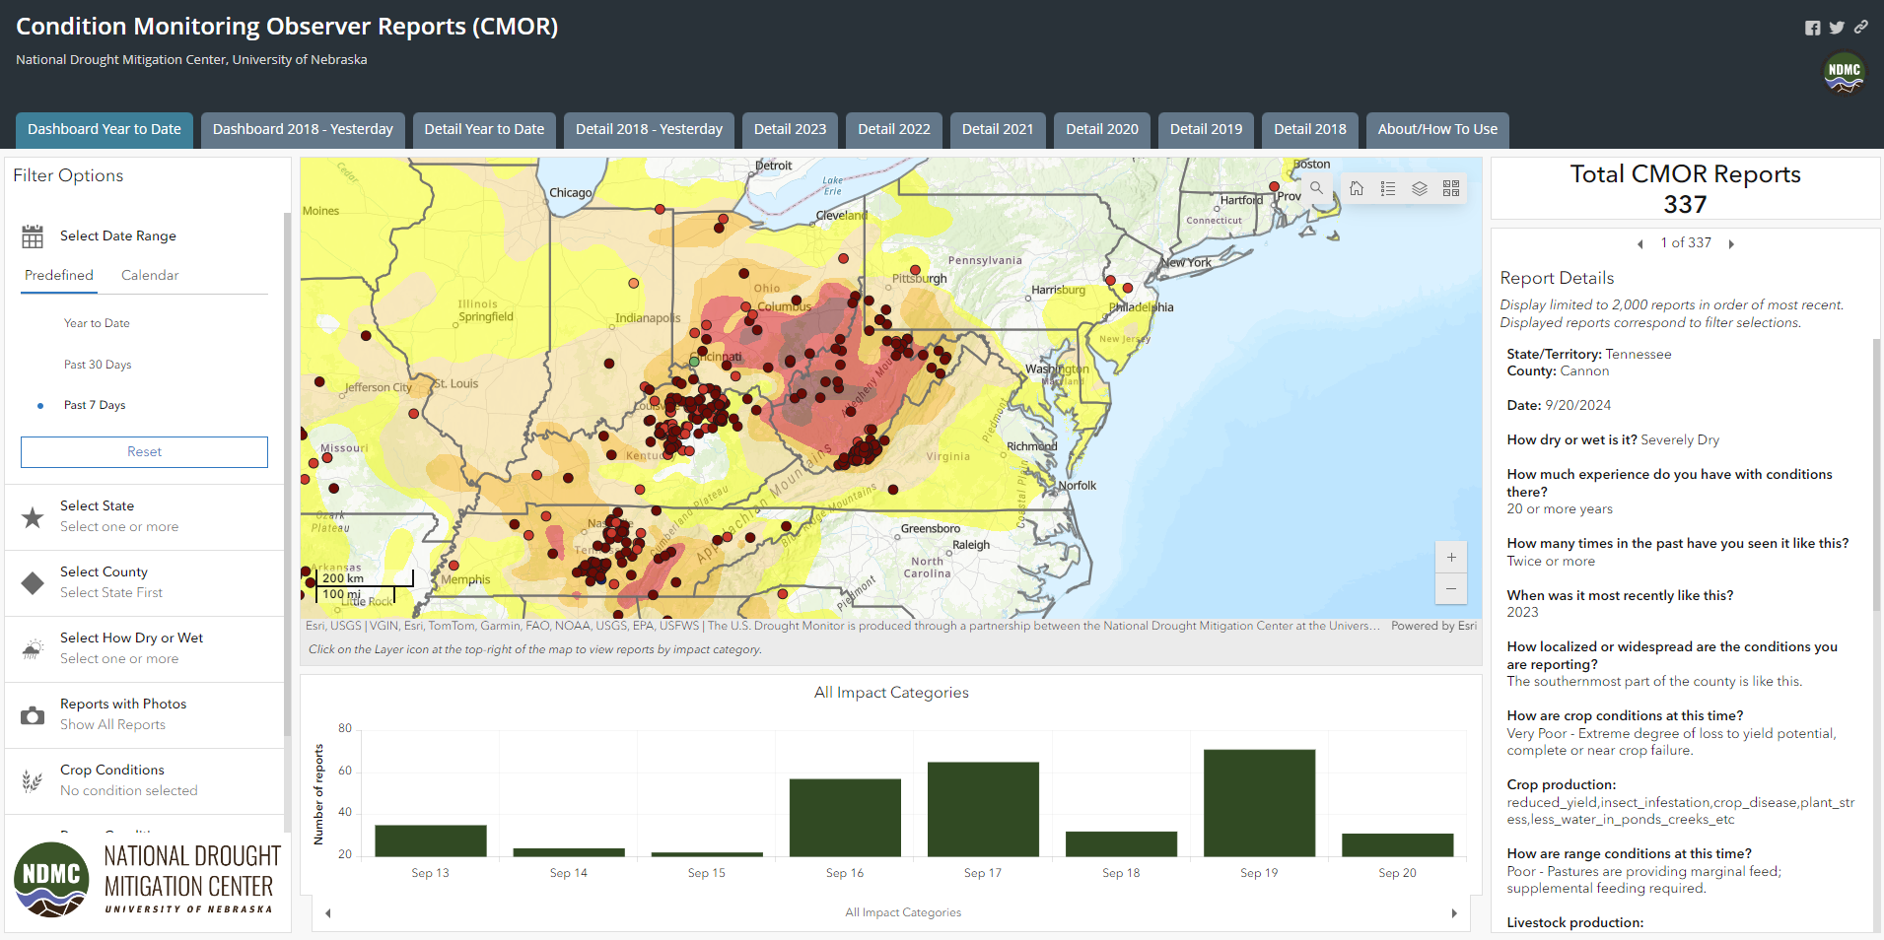
Help Monitor the Climate - Become a Citizen Scientist
During times of drought, citizens can share drought impacts by utilizing the Condition Monitoring Observer Reports (CMOR)
Reported impacts help us assess the intensity of the drought across the state and drive the production of the U.S. Drought Monitor product.
https://droughtimpacts.unl.edu/Tools/ConditionMonitoringObservations.aspx

Slide 35
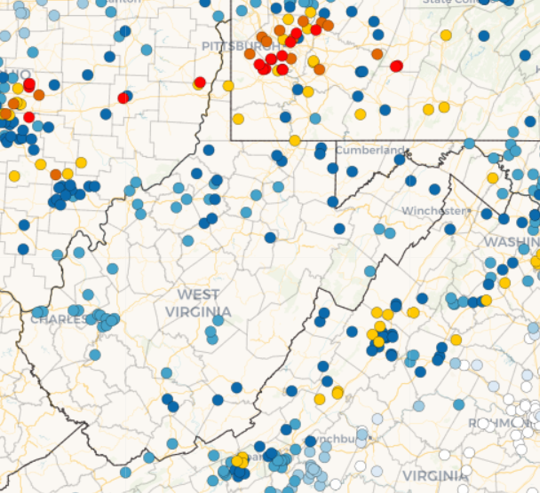
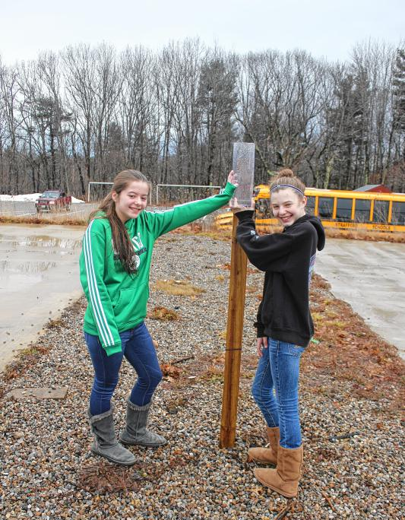
Help Monitor the Climate - Become a Citizen Scientist
CoCoRaHS - Community Collaborative Rain, Hail and Snow Network
CoCoRaHS is a volunteer network of observers who measure precipitation from their backyard – or school yard. Any age can volunteer.
It only takes a few minutes a day to take and record the measurements.
Students collect measurements and report the data.
Compare your data with other observers and other schools.
Multi-day reports can be submitted on Monday to cover any weekend precipitation.
Lesson plans and activities:
https://www.cocorahs.org/Content.aspx?page=CoCoRaHS-Schools-Teachers
www.cocorahs.org/ | www.cocorahs.org/Content.aspx?page=CoCoRaHS_Schools

Slide 36
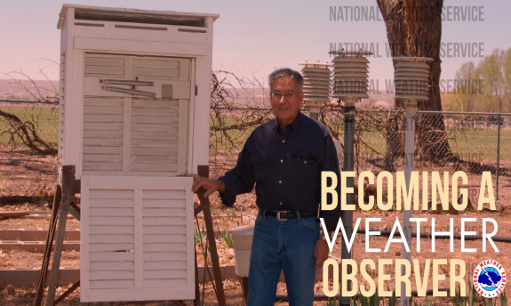
Help Monitor the Climate - Become a Citizen Scientist
We need Cooperative Weather Observers to fill in gaps in our climate monitoring network
We need observers in:
McDowell County
Lincoln County
Clay County
Randolph County
Barbour County
Measure daily high and low temperatures, rain, snow and snow depth.
The NWS provides the training and the equipment.
Observations need to be taken every day, seven days a week.
Can be an individual or municipality, i.e. water plant, 911 dispatch, fire dept.
https://www.weather.gov/rlx/weather-spotter#coop

Slide 37
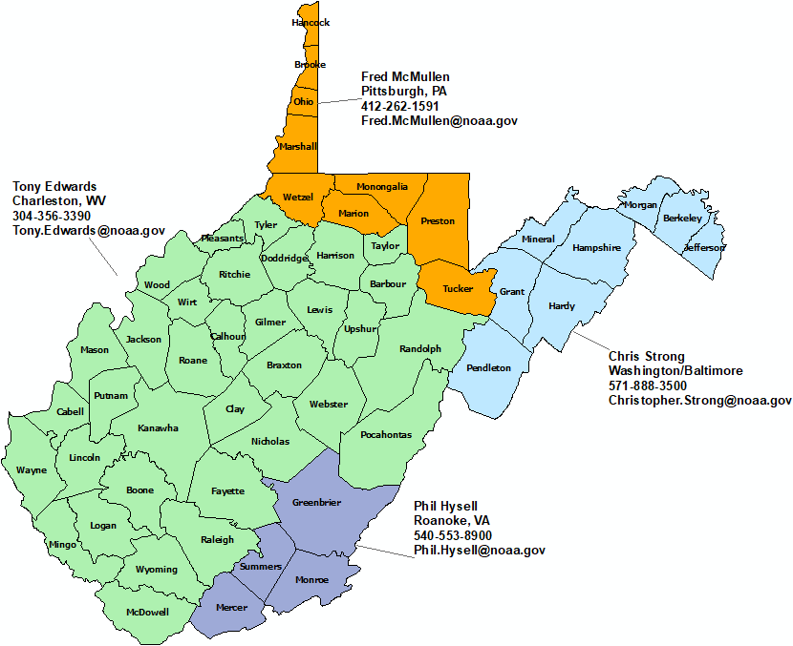
Thank You!
NWS Pittsburgh, PA
NWS Charleston
NWS Sterling,
VA
NWS Blacksburg, VA

