Slide 1
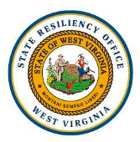
The West Virginia Flood Resiliency Framework
(WVFRF)
September 25, 2024
WV VOAD Conference
Jamie Shinn, PhD
SUNY College of Environmental Science & Forestry (ESF)

Slide 2
The Research Team
Dr. Jamie Shinn, Project Leader, Assistant Professor of Environmental Studies at the SUNY College of Environmental Science and Forestry (SUNY ESF)
Dr. Aaron Maxwell, Project Co-leader, Assistant Professor of Geography at WVU
Julian Levine, Project Co-leader, Director of Population Health & Community Engagement at the West Virginia School of Osteopathic Medicine Center for Rural and Community Health
Kurt Donaldson, Director, West Virginia GIS Technical Center
Eric Hopkins, Behrang Bidadian, & Annie Mahmoudi, West Virginia GIS Technical Center
Katherine Garvey & Jared Anderson, WVU Land Use and Sustainable Development Law Clinic
Robert Martin & Edwin Martin, West Virginia State Resiliency Office (SRO)
David Lumsden, Episcopal Diocese of WV
Paula Brown, Greenbrier County Homeland Security & Emergency Management
West Virginia Voluntary Organizations Active in Disasters (WV VOAD)
Debbie Sizemore, Williamsburg Area Response Team (WART)
Cathy Rennard, Former Disaster Case Manager Supervisor for WV VOAD
Andrea Cass, PhD student, SUNY ESF

Slide 3
More information available at: https://nsfcivicinnovation.org/

Slide 4
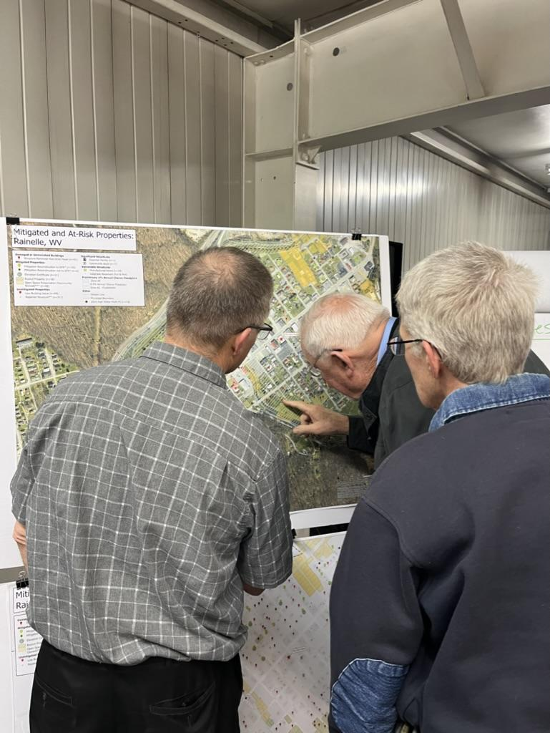
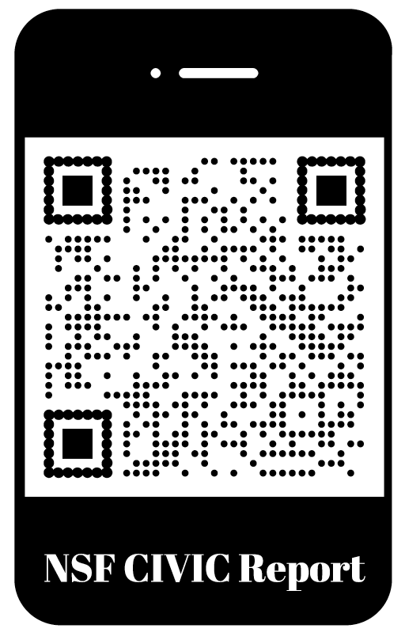
Stage 1 Award: Lessons Learned from 2016 Flood in Greenbrier County (2022-2023)
Survey of residents on flooding (2,215 responses)
Community and virtual focus groups to identify lessons learned
Creation of flood risk vulnerability maps and visualizations
Confirmed hypotheses:
Organizations in the response and recovery network require increased capacity
There is a need for improved cross network coordination
Additional flood risk knowledge is essential to better prepare communities for future floods
Read report at: https://www.greenbriercountyhealthalliance.org/civic-report
Presenting flood maps at community focus group in Rainelle, WV

Slide 5
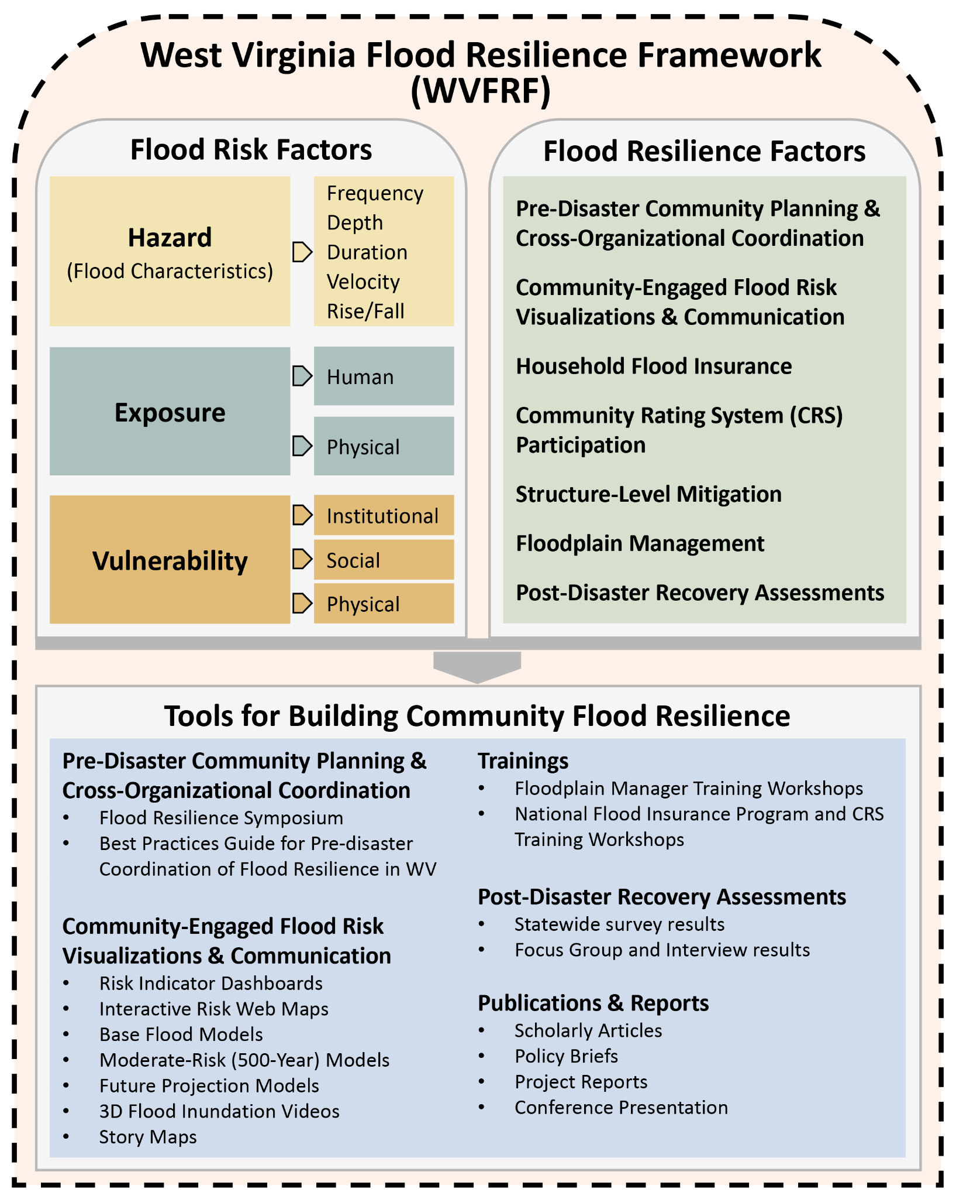
Stage 2 Award: Creating the WVFRF
$800,000, 12-month award, began Oct 1, 2023
Statewide survey on flood recovery and preparation
Flood risk indicator reports for all 286 floodplain communities
Flood risk visualization tools for high-risk communities
Floodplain management trainings
Symposium on Building Flood Resiliency in WV Communities
Creation of WVFRF: A freely available online resource for residents, local leaders, non-profit organizations, state and regional officials, and others to catalyze flood resilience for WV communities through improved flood risk knowledge, floodplain management, comprehensive disaster preparation, and long-term resilience planning
WVFRF conceptualization

Slide 7
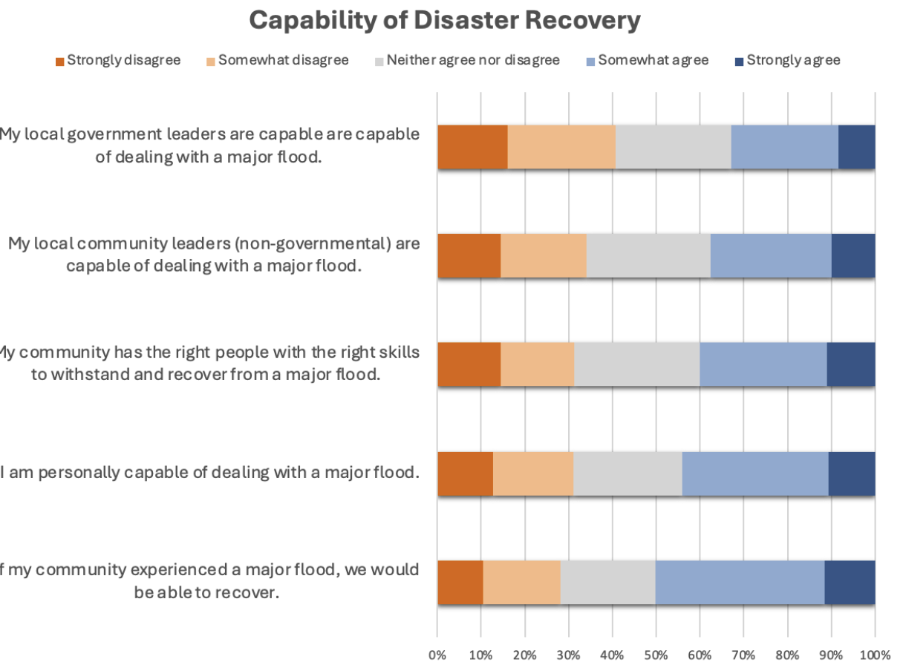
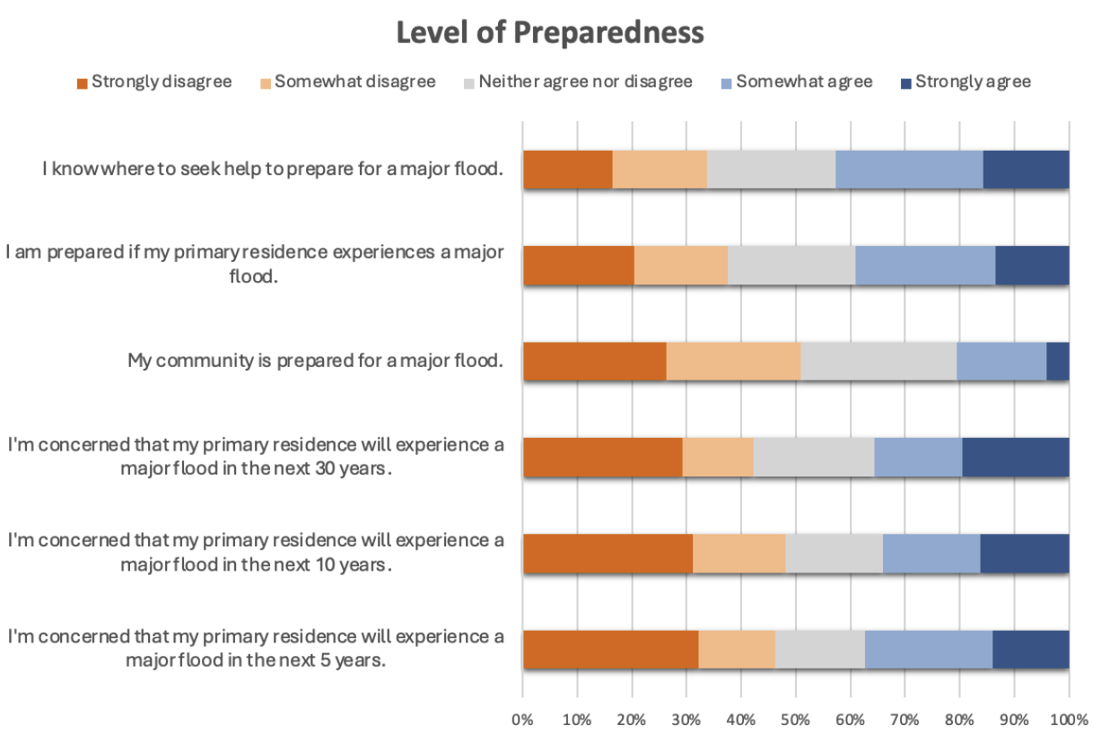
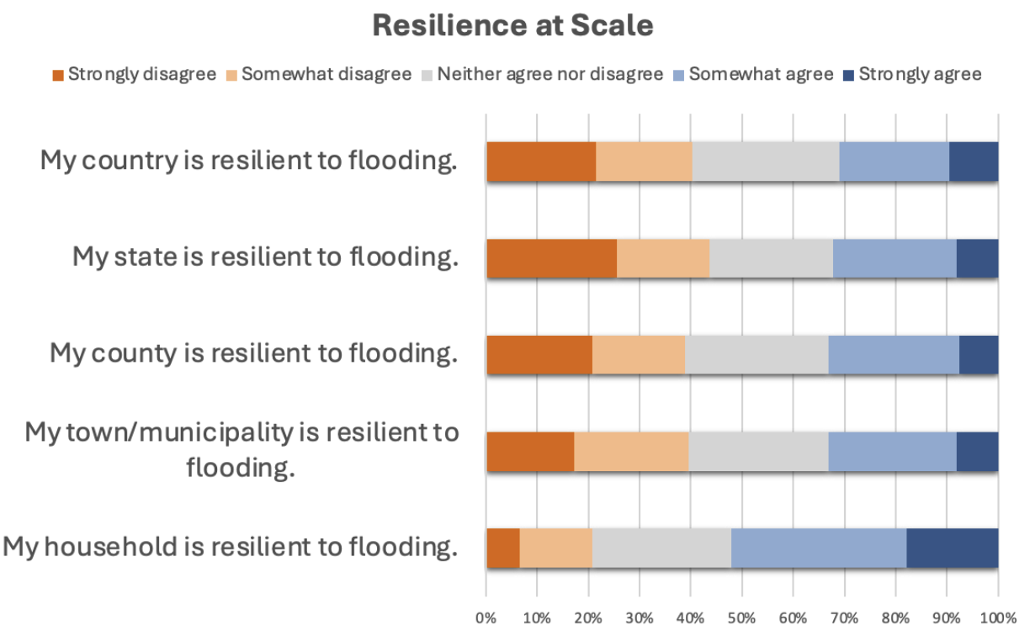
WV Survey on Flood Recovery & Preparation
February 2024 to May 2024
1,228 responses
Concentration of responses in Greenbrier, Kanawha, and Ohio Counties, all of which experience higher flood risk than national averages
Analysis nearly complete and data to be shared via WVFRF

Slide 8
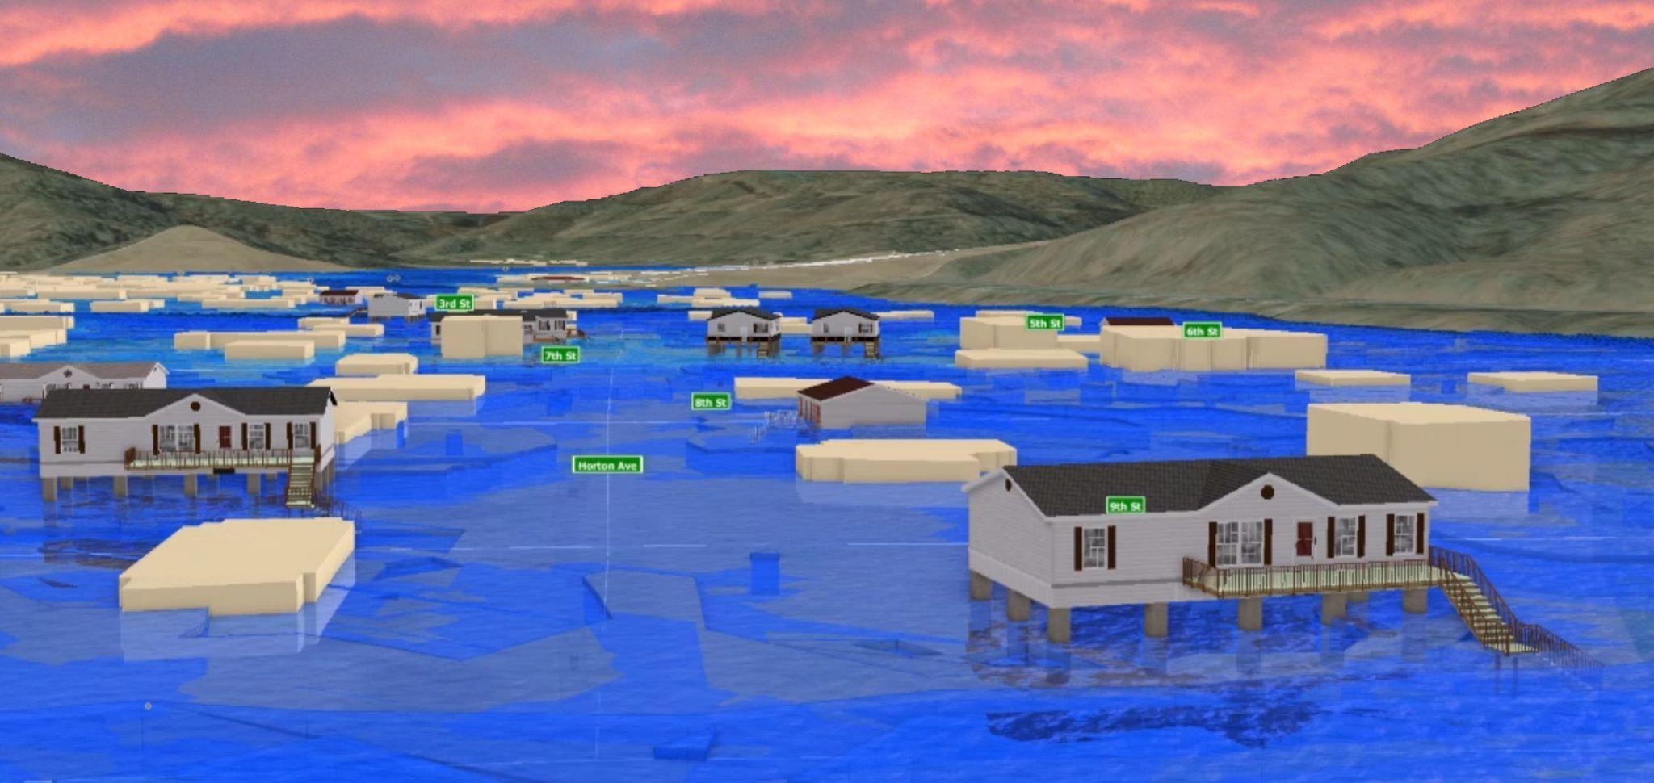
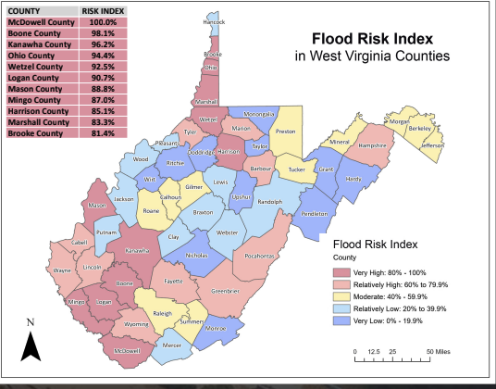
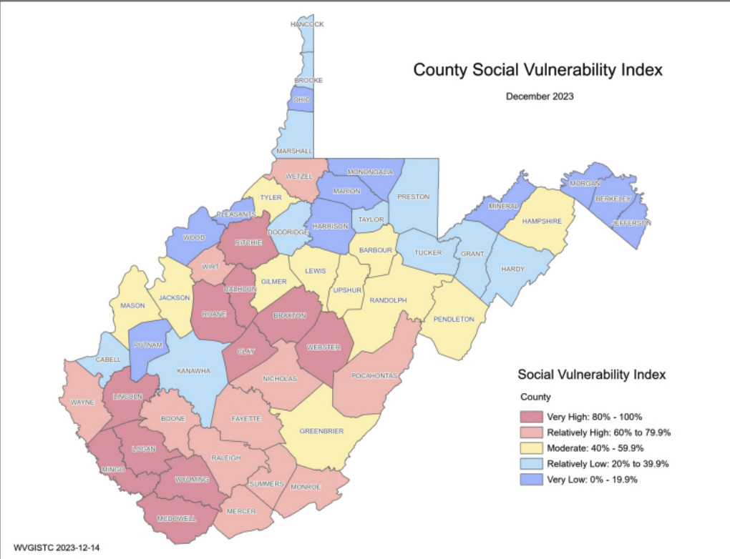
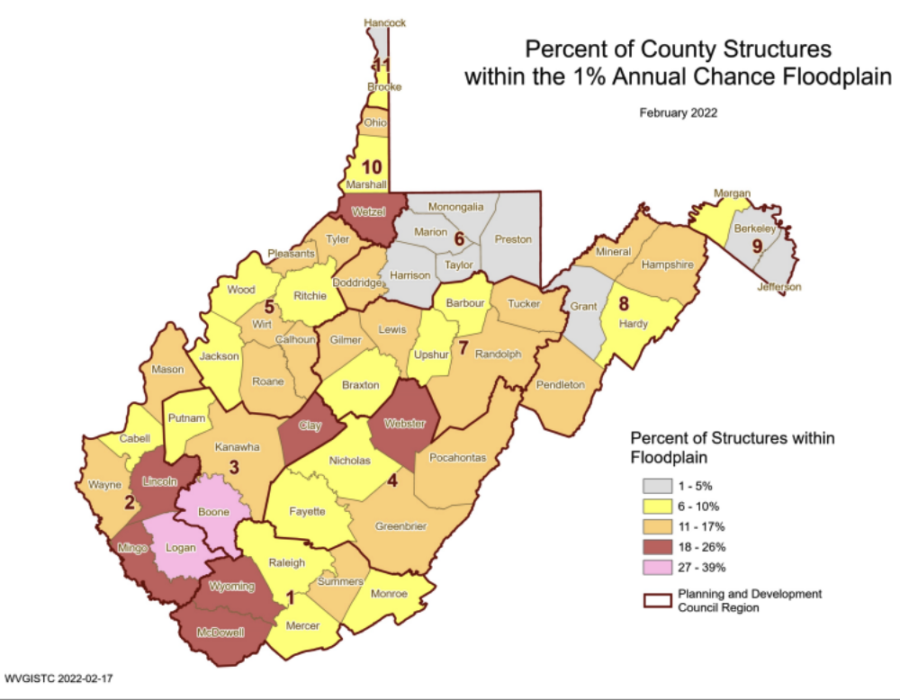
WV Risk Explorer
The WV Risk Explorer tool that can be used to understand and visualize riverine flood risk at nine geographic scales of analysis. Key components:
RISK MAPS to interactively view and explore risk indicators
RISK REPORTS to view and download risk assessment and comparison reports
VISUALIZATIONS of 3D and 2D flood models at community and building levels
DASHBOARDS to analyze risk factors and mitigation measures

Slide 9
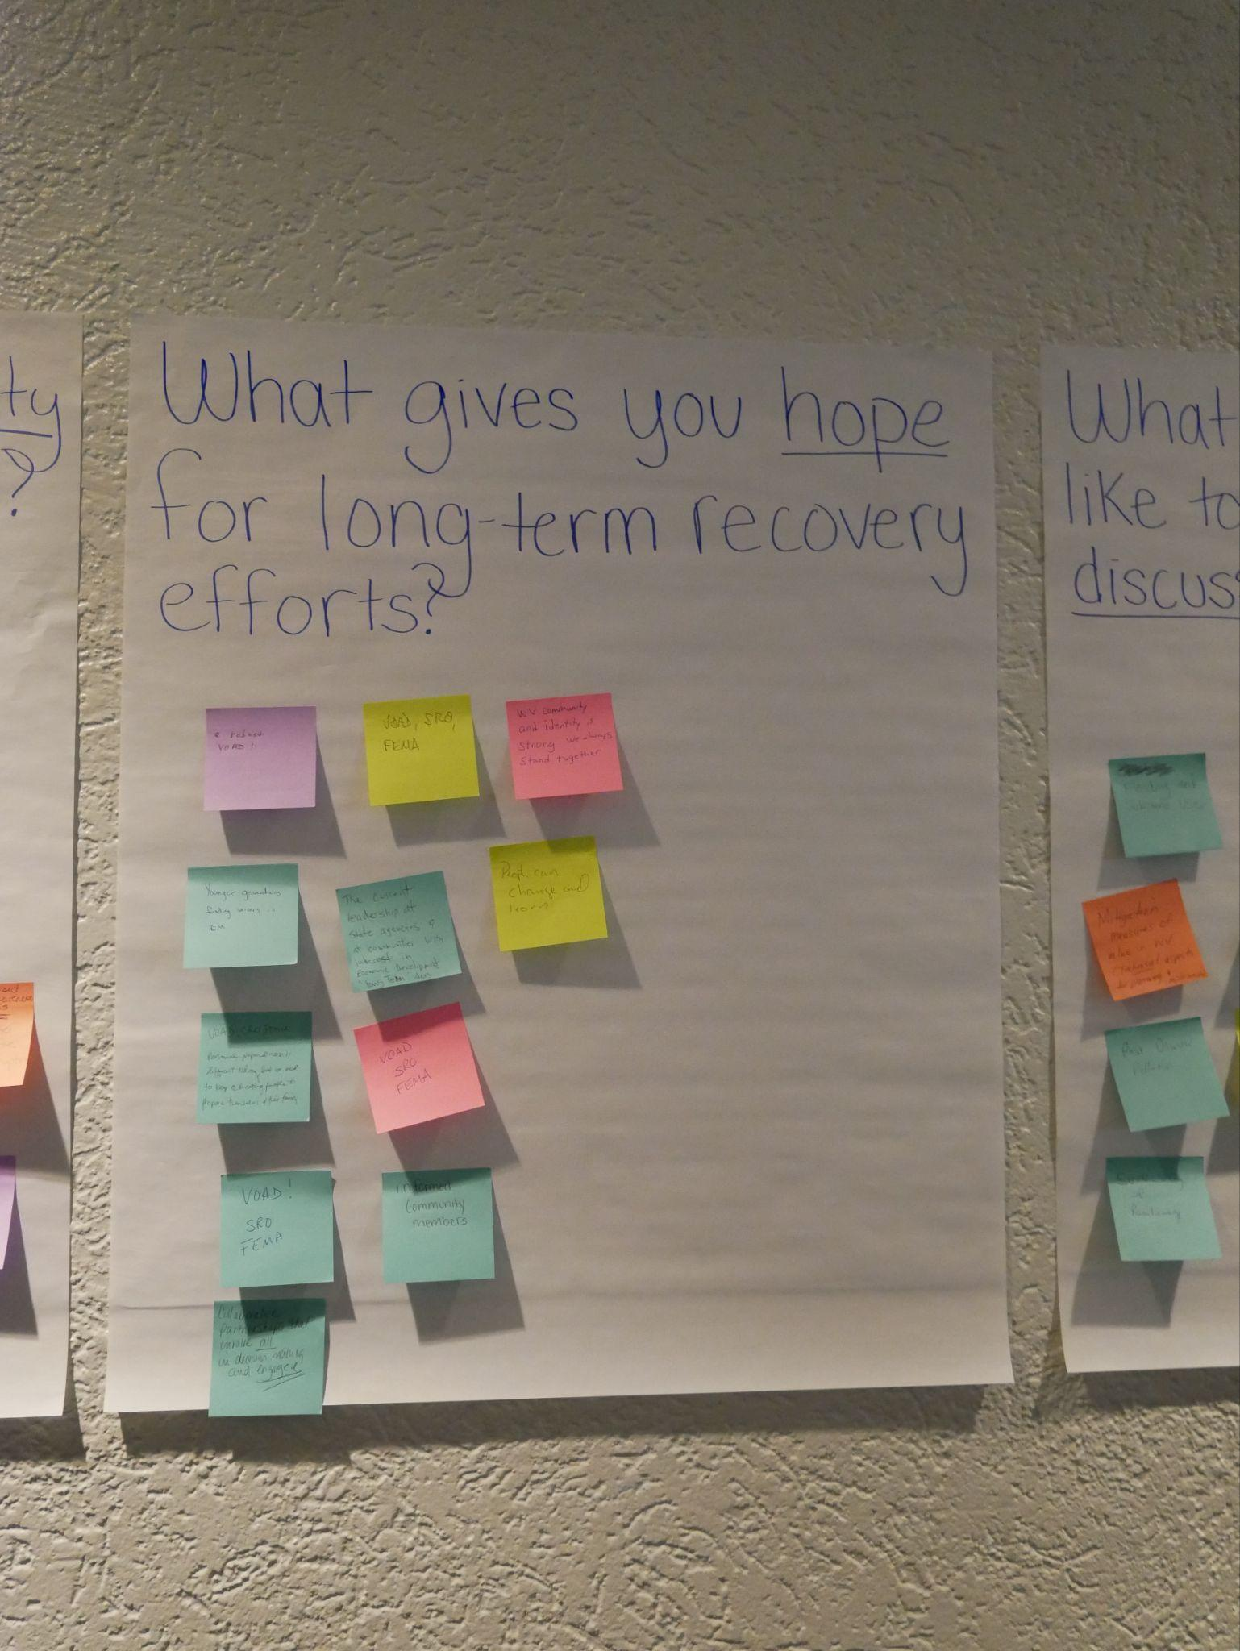
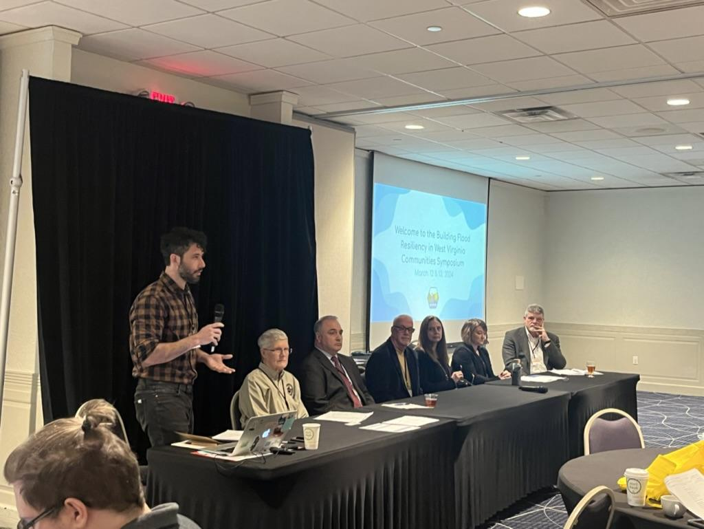
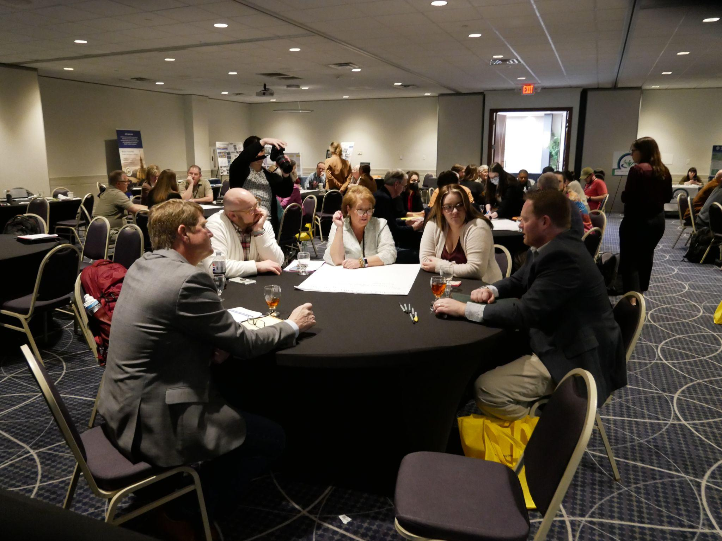
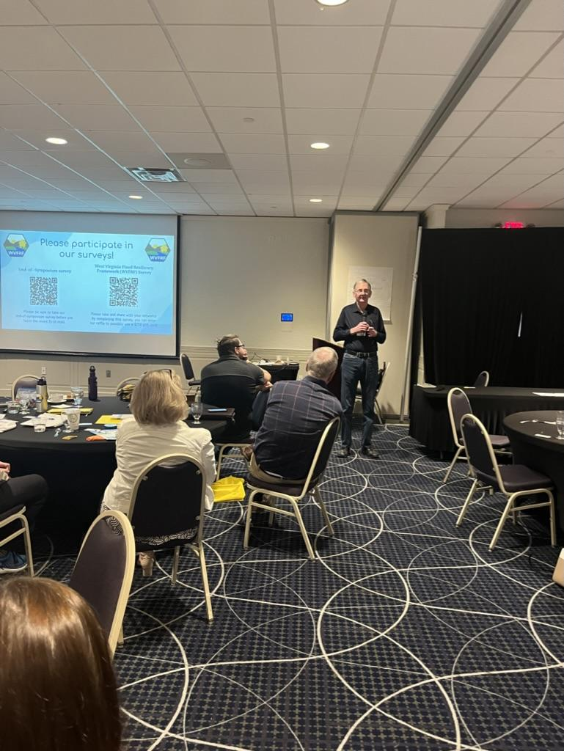
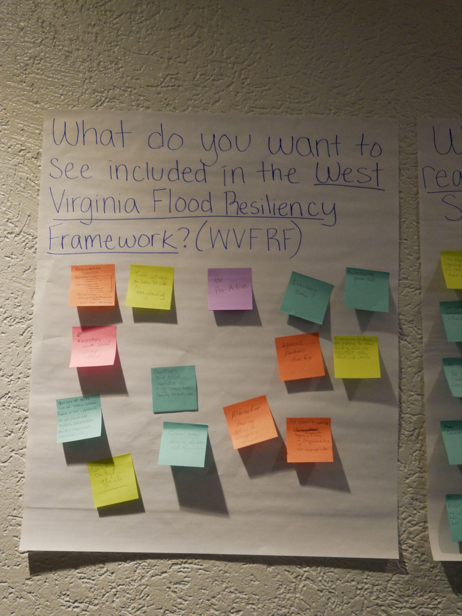
Symposium on Building Flood Resiliency in WV Communities

Slide 10
Symposium Goals
Create common understanding of who the main players are their capabilities before, during, and after a flood
Increase understanding of how each organizations can better coordinate efforts in each phase of a disaster
Deepen understanding of barriers to coordination between organizations
Identify considerations that contribute to or detract from community resiliency

Slide 11
Best Practices Guide for Disaster Preparation and Flood Response
(In Production)
Intended to assist communities or geographic areas across the state establish Community Organizations Active in Disaster (COADs)
COADs provide the platform for launching unmet needs groups in their communities in the event of a disaster, but they also do much more
Permanently established COADs will encompass the phases of emergency management: mitigation, prevention, preparedness, response and recovery
In final phase of production, to be shared for feedback and then made available on the WVFRF
Guide’s Table of Contents:
Before Disaster Strikes: Building Resiliency
Responding to a Disaster
After the Disaster: Recovery & Refining Resiliency

Slide 12
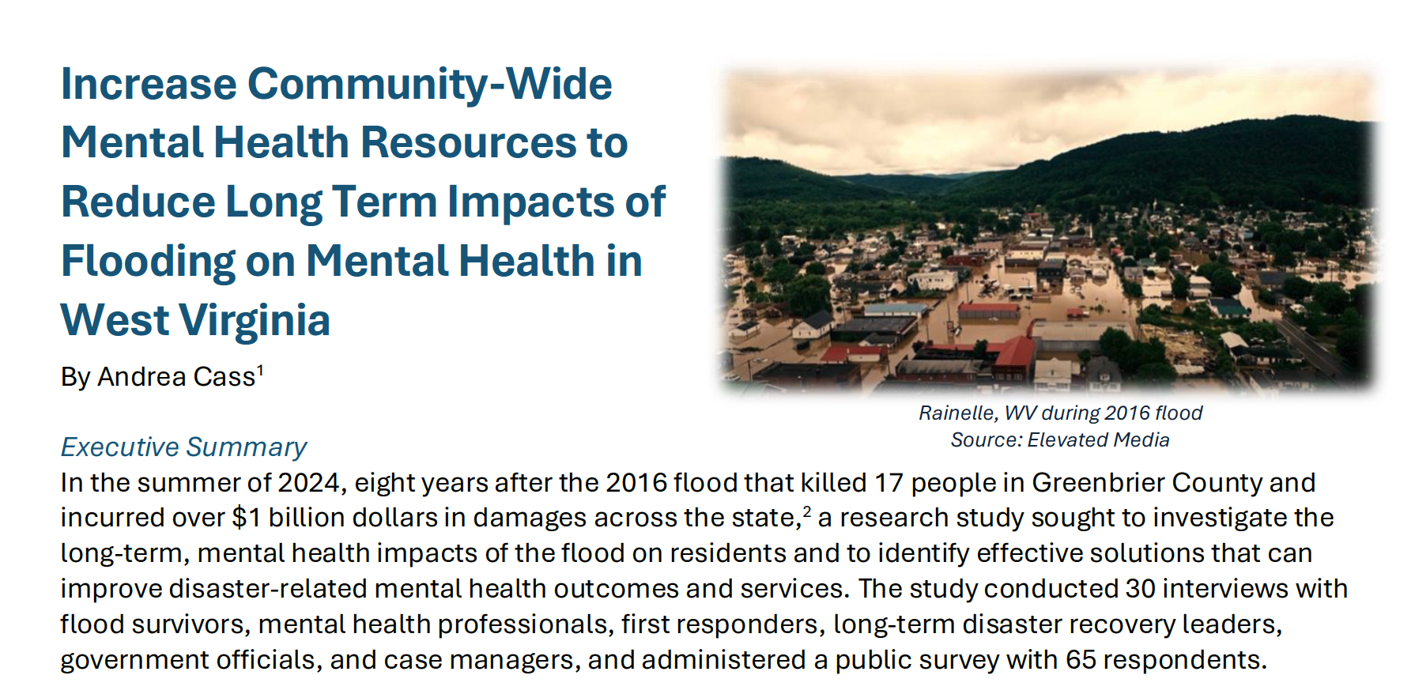
Next steps:
Launch the WVFRF (October 2024)
Market tool to every county
Train stakeholders
Communicate to policy makers
Procure funding for continued and expanded work

Slide 13
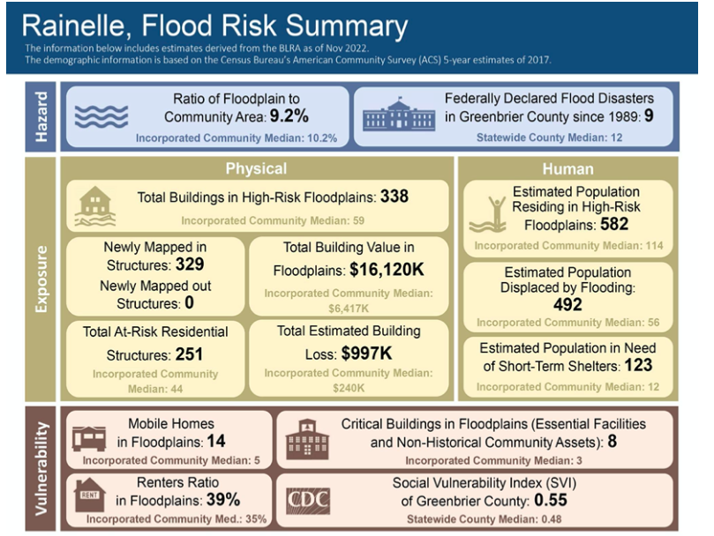
Thank you & Questions
Project Website: https://mapwv.gov/civic/
Contact: jeshinn@esf.edu
While designed for WV, project outcomes and processes will be transferable to communities across Appalachia and the US as a model for using social science and PGIS methods to create community-driven disaster response systems
Flood risk indicator report for Rainelle, WV

