Slide 1
National VOAD Resources for State/Territory VOADs
Amelia Mendizabal – Director of Programs
Bethany Piehl– State & Territory Program Associate
Notes:
2019 WV Slideshow? AM asking JW. Look to see if there are any good ST Videos

Slide 2
National VOAD Mission & Vision
Vision
National VOAD is recognized nationwide as the non-governmental leader building community resiliency throughout the disaster cycle. National VOAD members represent a powerful force of goodwill in America. They are the leaders who do the work to make our communities stronger and more resilient. In times of need they deliver hope for a more positive future.
Mission
National Voluntary Organizations Active in Disaster (VOAD) leads the VOAD movement, as a convener, thought leader, and advocate for a diverse group of organizations dedicated to serving communities throughout the disaster cycle.
Notes:
AM

Slide 3
History of National VOAD
Following Hurricane Camille, on July 15, 1970, voluntary organizations came together to meet and discuss how to improve responses.
Founding Organizations
Christian Reformed World Relief Committee
Mennonite Disaster Service
National Catholic Disaster Relief Committee
Society of St. Vincent DePaul
Seventh Day Adventist
American Red Cross
Southern Baptist Convention
Notes:
AM

Slide 4
National VOAD Movement
National Members: 55
Associate Members: 23
State/Territory VOADs: 56
Partners: 23
Notes:
AM

Slide 5
NATIONAL VOAD TIMELINE 1980 - PRESENT
During the 1980’s many local affiliates of National VOAD members began forming Local, Regional and State VOAD coalitions
2000’s
2020
2010’s
1980's
1990's
2023: Established four-year Strategic Plan
2009: Partnership
Program began
2020: Capacity & Capability Program Initiated
By the mid-1990’s, VOAD became a true national movement
2019: Established four year “Strategic Plan"
Notes:
AM

Slide 6
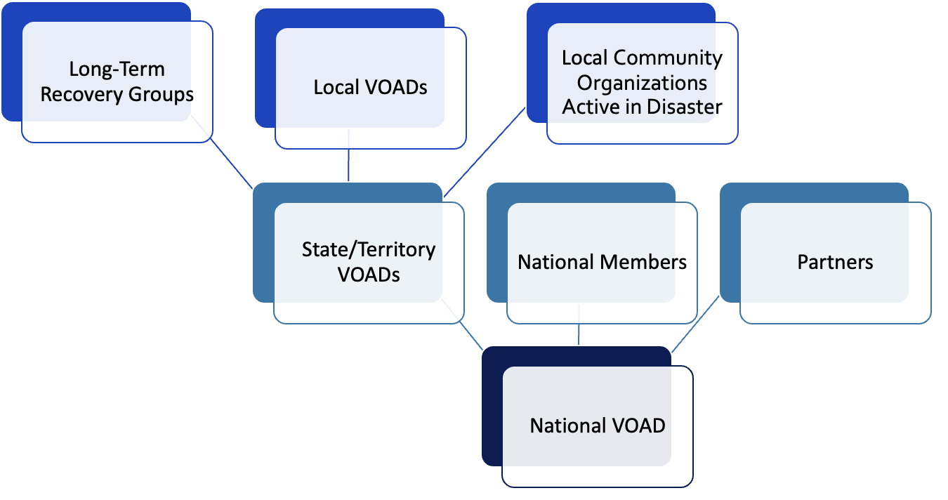
The VOAD Network
West Virginia VOAD
Notes:
Add WV would be here

Slide 7
DEFINING OUR ROLES-Understanding Our Relationship
West Virginia VOAD
NATIONAL VOAD'S ROLE
WORKS TO UPDATE THE NETWORK ON ORGANIZATIONAL DISASTER PROGRAMMING
ANNUAL DUES & COMPLETE TRIENNIAL & ORG. UPDATES
PRACTICE 4C'S DURING BLUE & GRAY SKIES
PROVIDE REPRESENTATION DURING FALL MEMBERS MEETING & NATIONAL VOAD CONFERENCE
UPHOLD MEMBER AGREEMENT PROVISIONS
DEVELOP PROGRAMMING & PARTNERSHIPS TO BENEFIT NETWORK
OFFER COORDINATION TOOLS: YAMMER & MEMBER PORTAL
HOST BI-WEEKLY OPS & OTHER COORDINATION CALLS AS NEEDED
COORDINATE AND ADVOCATE DURING BLUE & GRAY SKIES
PROVIDE GRANT & OTHER RESOURCING OPPORTUNITIES
Notes:
AM

Slide 8
National VOAD Programs
Member Services
Grants
Financial and in-kind support of disaster operations
State/Territory VOAD Capability & Capacity Project
Assess and build the capabilities and capacities of State/Territory VOADs
DART
Technology platform to support coordination of services
National VOAD Conference
Annual conference focused on voluntary disaster sector.
Support response/recovery coordination of membership
Notes:
BJ

Slide 9
CAPACITY & CAPABILITY ENHANCEMENT PROJECT (Phase 1)
Initiated in 2020 thanks to a grant from Margaret A. Cargill Philanthropies.
2020-2022 Goals
Build capacity within State/Territory VOAD Leadership
Incorporate data & technology to facilitate collaboration and illustrate impact
Increase diversity amongst State/Territory VOAD membership
Develop sustainable funding strategies
Notes:
Listing Goal for 2019 – 2022
What was accomplished in original grant
Network wide Cohorts and highlight WV
LEAD
List Goal 2023 – Now
Resrouces
What does this mean for WV VOAD

Slide 10
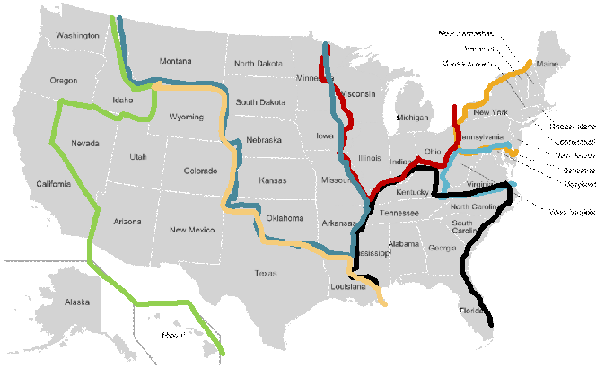
2021 Regional Cohorts
- Midwest (10)
- Southeast & Islands (10)
- Northwest & Islands (9)
- Central Atlantic (5)
- Northern Atlantic (9)
- Great Lakes (5)
- Southwest (8)

Slide 11
2021 State/Territory VOAD Website Redesign
Website Capabilities
Showcase Impact to Donors
Membership Directory
Internal Communications Platform
Online Donations Collection
West Virginia VOAD Website
About Us
Disaster Portal
Join the Movement
VOAD at Work
Donations
Multiple User Portals

Slide 12
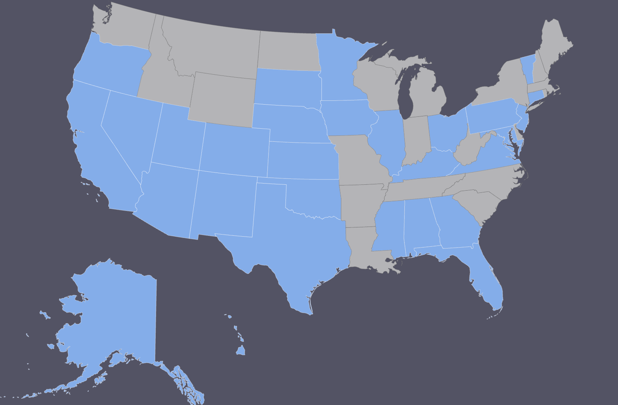
2022 – Learning Management System
30 States
71 Registered Users
8 Modules
LEAD 2.0 – Support Designed for State/Territory VOADs
8 Modules:
VOAD 101
Governance
Role of the Board
Membership Engagement
Local/Regional VOAD Support
Whole Community Engagement
Communications
Financials
2022 Pilot by the Midwest Cohort
2023 National Launch

Slide 13
CAPACITY & CAPABILITY ENHANCEMENT PROJECT (phase II)
2023-2025 Goals
Intentional relationship building with VOAD Leaders
Build Relationships with Tribal Leaders
Leverage New and Existing Technology Platforms
Develop sustainable funding strategies
Notes:
Listing Goal for 2019 – 2022
What was accomplished in original grant
Network wide Cohorts and highlight WV
LEAD
List Goal 2023 – Now
Resrouces
What does this mean for WV VOAD

Slide 14
Resource Development
Identified Need
Topic Discussion
Drafted Document
Review
Internal Review
State/Territory VOAD Leadership Feedback Survey
Published
Finalized and Watermarked
Shared via NVOAD Member Portal & Lead 2.0
Feedback Reviewed & Edits Made

Slide 15
Resources
New Additions
Coordination Call Template
National VOAD Ad-Hoc Committee Overview
ST VOAD Sample – Template Membership Agreement
ST VOAD Executive Leadership Toolkit
Sample Membership Categories for ST VOADs
VOAD Branding Quick Guide: Terms, Abbreviations, and Definitions
Coming Soon
ST VOAD Sample Dues Structures
ST VOAD Website Q&A

Slide 16
2023-2024 ESRI: ArcGIS Opportunities
6 Virtual Instructor Lead Trainings
ArcGIS Exploring the Possibilities
Arc GIS: Creating Essential Workflows
Creating Stories with ArcGIS
Leading for Success Workshop Series
58 Attendees

Slide 17
2024 Strategic Plan
Provide a positive, engaging and transformative experience for current and future members
1
Ensure a sustainable business development plan for present and future growth
2
Lead the sector and influence systems change through advocacy and thought leadership
3
Integrate a culture of diversity, equity, inclusion, belonging and access into the foundation of National VOAD
4
Notes:
How does this all connect?

Slide 18
Engaging the Movement
2023 National VOAD Conference
2024 National VOAD Conference
May 19-22nd, 2025
The Galt House, Louisville, KY
Notes:
Add Logo of AZ, and Galt House

Slide 19
Engaging the movement
2024 Fall Members Meeting
Oct 21-23rd, 2024 Alexandria VA
Member Representatives, State Territory VOAD Leadership, Partners

Slide 20
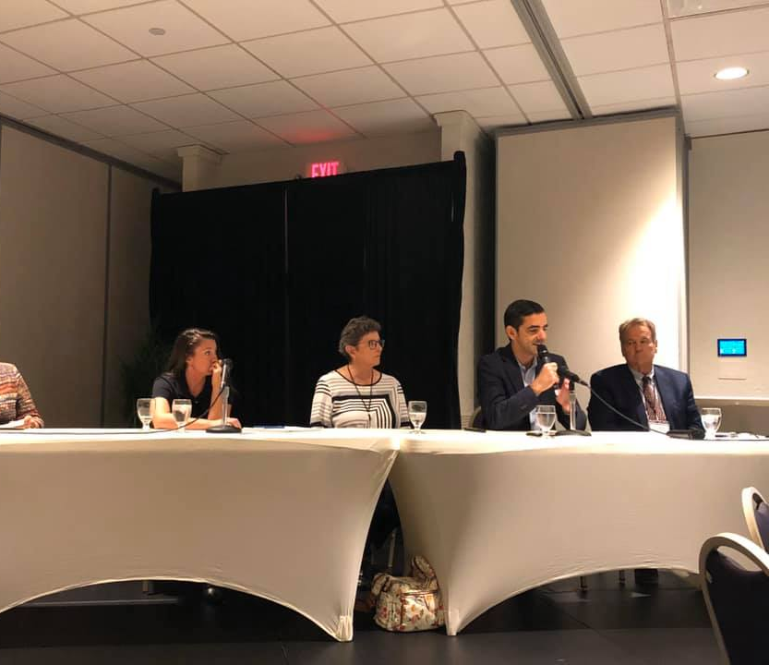
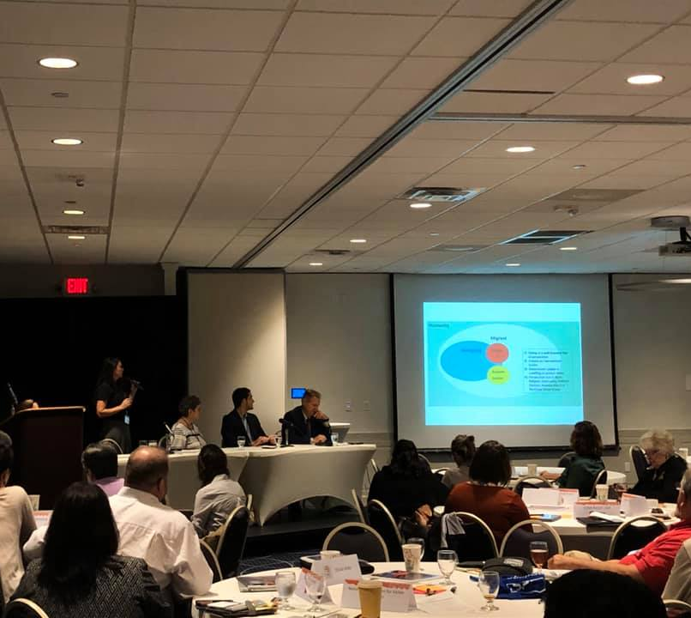
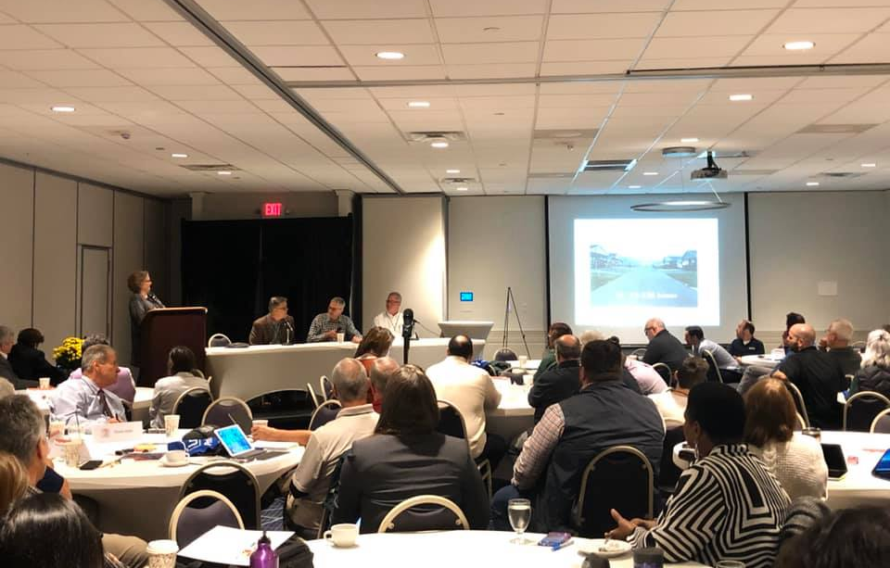
Rewind 2019 FMM – Charleston, WV
101 Attendees
36 National Members
4 Associate Members
12 State/Territory Members
9 Partners
10 Presentations
2 Moderated Panel Sessions

Slide 21
Questions?
Visit our website at nvoad.org
Follow Us on FB, IG, X
Contact our team info@nvoad.org

